Slide 1
Caring for the COVID ICU Patient
Division of Pulmonary and Critical Care

Slide 2
Special Considerations for the COVID-19 ICU Patient
Appropriate PPE
Acute hypoxemic respiratory failure/ARDS
Increased sedation needs
Shock
  Usually septic shock
  Can be cardiogenic shock
Special treatment options
Increased secretions /airway clearance
Rounding logistics
Family communication and support

Slide 3
Case Example
A 59 y/o man with a history of HTN and DM presents to the ED with low-grade fever, cough, and modest SOB. He has mild bilateral lower lobe infiltrates. He is COVID + and requires 2 L NC.
He is admitted to the floor. Overnight, his O2 requirement increased from 2 to 6 L. He does not appear in respiratory distress.
What is your next step?

Slide 4
Is a MICU Consult Needed?
Page COVID-19 MICU triage pager
* Special attention to persistent hypoxemia (SpO2 < 90%, PaO2 <65 or P/F < 300) despite FiO2 0.50 or 4-6L NC or rapidly increasing O2 requirements

Slide 5
Case Example
The patient is desaturating and placed on a NRB and transferred to the COVID ICU.
How do PPE recommendations change when caring for patients in the ICU?

Slide 6
PPE, Rounding and Daily Assessments

Slide 7
PPE Recommendations for Care of COVID-19 Patients in the ICU
N95 respirators are worn for all patient encounters
  The N95 may be used continuously between patients and safely stored unless damaged/soiled
  Extreme caution not to contaminate self when donning/doffing the N95
Contact precautions: gown and gloves
Eye protection: goggles or face shield
  Perform hand hygiene before and after touching eye protection
  Eye protection may be worn continuously and disinfected rather than disposed
Consider covering hair
Recommend scrubs

Slide 8
Rounding Logistics in the COVID-19 ICU
“Bedside” interprofessional rounds are conducted in front of each patient’s room
Team does not enter room after discussion
  If any vent or drip changes are needed, ask for changes before nurse/RT leaves the room
  Clear communication with nurses to minimize number of entries into the room
  All monitors and vents are turned outward to be seen outside the room
  Examination of patients occurs after rounds completed
    “pre-rounding” by the resident/APP is not necessary but enter the room for acute patient care needs
    Either the fellow or the attending will examine the patients
    Evaluate patients once daily to conserve PPE

Slide 9
Items to be Assessed Daily on Each Patient (as appropriate)
Vitals with trends
I/0’s-what output is what:
  Urine, stool, chest tube, other drains, NG
Antibiotic duration
For mechanically ventilated patients
  Date intubated
  Size of tube (can put in physical exam)
  Vent settings with ABG if appropriate
  Peak and plateau pressures and compliance when relevant
ICU checklist

Slide 10
ICU Checklist-FAST HUGS BID
Things that impact morbidity and mortality in the ICU
Feeding- enteral feeding early
Analgesia
Sedation
Thromboprophylaxis
HOB >45 degrees- decrease aspiration risk
Ulcer prophylaxis
Glucose control: goal 85-180
Skin- deep tissue injury
Bowel
Indwelling lines and catheters
  Femoral lines-3 days
  IJ or subclavian-7 days
  PICC-14 days
  Foleys-out as quickly as possible
De-escalation of antibiotics

Slide 11
Case Example
The patient is saturating 95% on a 100% NRB. He is not in acute distress but is tachypneic.
Do you recommend a trial of HFNC or NIV?
Should he be intubated?

Slide 12
Managing Severe ARDS in the COVID Patient

Slide 13
When to Intubate a COVID-19 Patient
We have found patients with COVID-19 can decompensate rapidly.
It is safer to intubate a patient with some respiratory reserve in a controlled setting, rather than intubate rapidly in an emergency.
Once a patient requires 6L of nasal cannula to support their oxygen saturations >90%, consider discussing intubation with the anesthesia team.

Slide 14
Case Example
The patient is intubated by anesthesia.
How do you select appropriate initial vent settings?

Slide 15
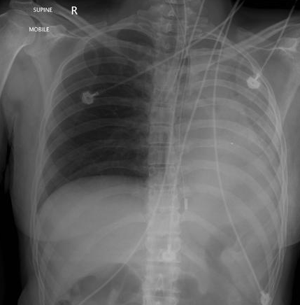
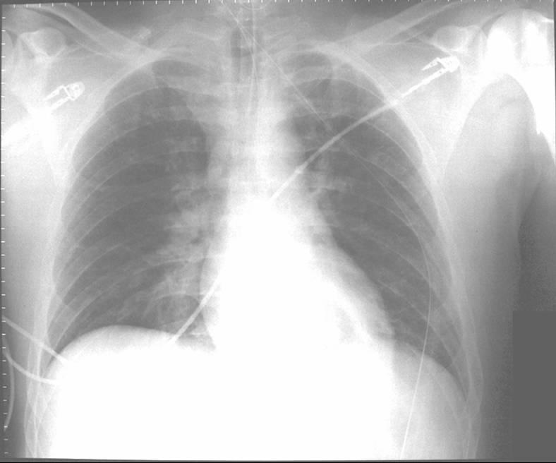
Immediate Post-Intubation Evaluation
ETT tip
Capnography
Visualization (laryngoscopy, bronchoscopy)
Tube condensation
Breath sounds and chest rise
Increasing SpO2
Appropriate tube size (number indicates the internal diameter in mm)
CXR: ETT tip 2- 5 cm above main carina
ABG 15-30 minutes afterward
2 – 5 cm
Main carina
Properly Placed ETT
Right Mainstem Intubation

Slide 16
Common Initial Default Ventilator Settings
Mode
RR
V_{T}
FiO₂
PEEP
V_{i}
AC/VC
14-20
RR and TV will affect PaCO₂
6 cc/kg
0.40 - 1.0
FiO2 and PEEP will affect PaO₂
5 cmH₂O
.
(flow) 60-70 L/min, decelerating (ramp)
ABGs, airway pressures, clinical management, and synchrony will guide subsequent changes.

Slide 17
Most Common Initial Mode
  Assist/Control (AC)
  Both spontaneously triggered breaths and timed (controlled) breaths get “assisted” by the ventilator to deliver the same set volume
    AC/VC = assist control, volume control
        Set a tidal volume (V_{t}) and flow (V)
        Pressures and inspiratory time are the dependent variables (outcomes, cannot be directly controlled)

Slide 18
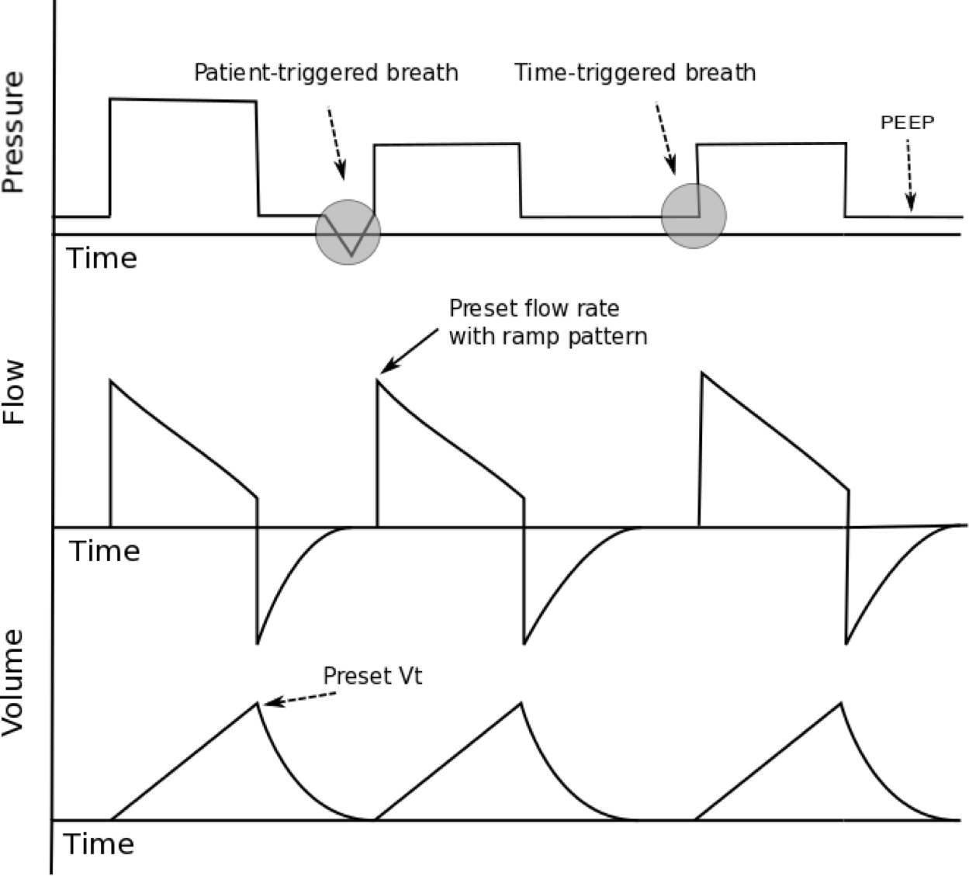
AC-VC
A = assisted
C = controlled

Slide 19
Getting the Right Vent Settings: ARDS Ventilation
In the MICU, we usually start with Volume Control. This means you set:
  Respiratory Rate
  Tidal volume
    In COVID-19 patients, we aim for ‘low tidal volume ventilation’
    This means 6-8cc/kg of ideal body weight.
  FiO2 (%)
  Positive end-expiratory pressure (PEEP)
    Use higher levels of PEEP (12-15 cmH2O)

Slide 20
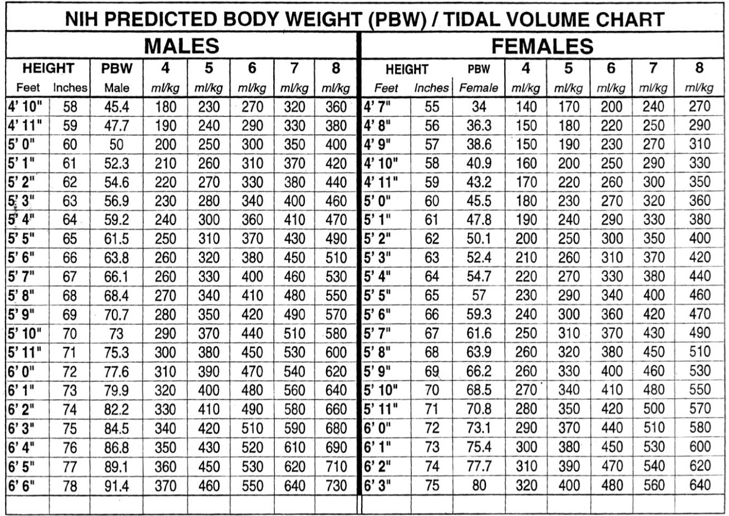
Getting the Right Vent Settings: Tidal Volume
Tidal Volume:
  Use this handy chart!! Easily found online from ARDSNet

Slide 21

Getting the Right Vent Settings: fiO2
Fraction of inhaled Oxygen (FiO2)
  Goal spO2 is 88-95%
  Goal PaO2 is 55-80
  Make sure you’re basing decisions on a good waveform!
  Oxygen therapy can be toxic. In general, we risk injury from hyperoxia above 60% fiO2. If you’re getting above that threshold, consider trying other therapies, such as increasing PEEP and proning

Slide 22
Getting the Right Vent Settings: PEEP
Positive End Expiratory Pressure (PEEP)
  We have found that patients with COVID benefit greatly from increasing PEEP. Make sure you’re making the most of it!
  Increasing PEEP will increase the Plateau Pressure. Try to keep the Plateau Pressure less than 30 cm H2O.
  PEEP is often underutilized. One guideline, from the PROSEVA trial, can be found below:

Slide 23
What is a P/F Ratio?
The P/F ratio is the ratio of the PaO2 to the fiO2.
For instance, if a patient has a PaO2 of 80 on 90% fiO2, the P/F ratio is:
80/0.9 = 88.9
If the P/F ratio is >150, the patient is doing well on current management.
If the P/F ratio is <150, consider PRONING

Slide 24
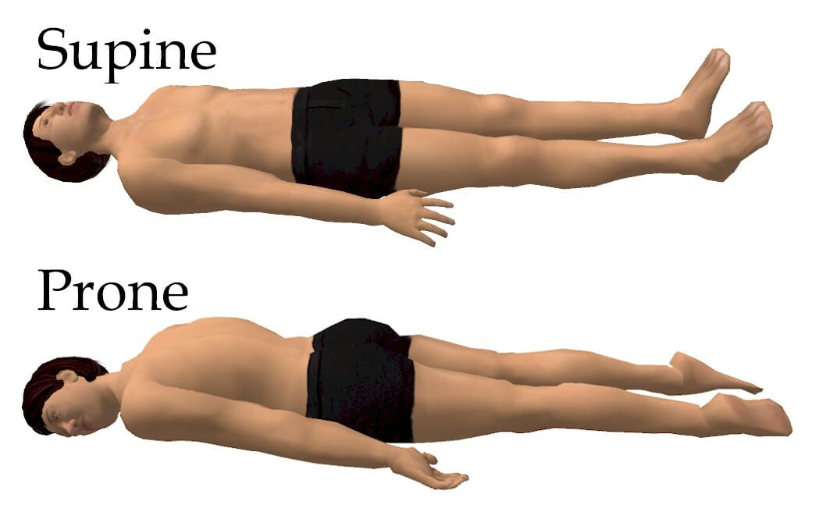
What is Proning?
Proning improves oxygenation by redistributing blood flow towards parts of the lung with better ventilation
Every patient with a P/F ratio of <150 should be considered for prone positioning
Does NOT need a special bed: can be done in traditional ICU beds

Slide 25
Proning: Special Considerations
Contraindications to proning:
Ventral burns or wounds
Spinal instability
Open chest
Refractory shock (3 or more vasopressors)
Unstable arrhythmias
Third trimester pregnancy
Increased ICP
Increased intraocular pressure
Recent cardiac arrest
Anterior chest tube with air leak
Reasons to stop proning:
Hemoptysis
SpO2 <85% or PaO2 <55 mmHg on FiO2 0.8 for >15 minutes
PaCO2 >60 mmHg OR pH <7.20 for >3 hrs
Plateau pressure >35 for >30 minutes
Unstable arrhythmia
Need for 3 or more vasopressors or addition of 2 new vasopressors

Slide 26
COVID-19 ARDS Vent Management Algorithm
Lung Rescue (ECMO) 5-5555. You may ask for help
from any PCCM fellow or attending.

Slide 27
Case Example
After intubation, the patient appeared comfortable with adequate oxygenation and ventilation on your initial ventilator settings. You were able to titrate down the FiO2 to 50%.
1 hour later, the nurse informs you that the patient is agitated and saturating 86% despite increasing the FiO2 to 100%.
What is your approach to sedation for this patient?

Slide 28
Sedation in the Intubated COVID-19 patient

Slide 29
Sedation in the ICU
Our experience shows that COVID-19 patients appear to require higher levels of sedation.
Development of agitation and delirium is associated with:
  Acute hypoxemia
Deep sedation may be indicated to ensure patients are synchronous with the ventilator.
  Initial sedation is typically fentanyl and Propofol or precede
  Consider early use of ketamine or benzos if limited by sedation-related hypotension
  Before neuromuscular blockade can be initiated, patients must be deeply sedated (need RASS of -4 to -5)

Slide 30
Sedation Considerations
Anticipate adverse effects of prolonged infusions:
Prolonged fentanyl infusions lead to tachyphylaxis requiring alternative agents
  Hydromorphone or morphine
  Aggressive bowel regimen needed
Prolonged, high dose Propofol can lead to hypertriglyceridemia and Propofol infusion syndrome (PRIS).
  Monitor weekly triglycerides
Prolonged lorazepam infusions can lead to propylene glycol toxicity
  Alternative medication is midazolam

Slide 31
Case Example
After achieving deep sedation with fentanyl and propofol, the patient develops hypotension. You add lorazepam and titrate off the propofol. However, he remains hypotensive. You give a 1 L fluid bolus but his BP remains 80/40.
What is your next step?

Slide 32
Managing Shock in the COVID-19 Patient

Slide 33
Patterns of Shock
SHOCK | CO (Pump Function) | CVP (Preload) | SVR (Afterload) | Tissue Perfusion (ScVO₂)
Cardiogenic | DOWN | UP | UP | <65%
Obstructive (PE) | DOWN | UP | UP | >65%
Hypovolemic | DOWN | DOWN | UP | <65% (late)
Distributive (septic shock) | UP | DOWN | DOWN | >65%
Notes:
other causes of of distributive shock include anaphylaxis, adrenal insufficiency, neurogenic/spinalß

Slide 34
Surviving Sepsis for COVID-19 patients
Consider a conservative approach to fluid resuscitation (a little less may be more in these patients to help with oxygenation)
Use crystalloids over colloids
Use norepinephrine as the first-line vasopressor
  Consider angiotensin II as a second-line agent if available
  Otherwise, second-line agents: vasopressin or epinephrine
Monitor for development of cardiogenic shock
  Reports of myocardial injury due to coronavirus
We do NOT recommend corticosteroids in these patients unless concern for adrenal insufficiency or presence of refractory shock
Alhazzani et al. Surviving Sepsis Campaign: Guidelines on the Management of Critically Ill Adults with Coronavirus Disease 2019 (COVID-19). 2020

Slide 35
Vasoactive Medications- “Pressors”
Name | Starting Dose | Max Dose | Mechanism | Caveat
Norepinephrine | 2-5 mcg/min | 30 mcg/min | Vasoconstriction | Some ionotropic
Vasopressin | 0.04 units/min | Not titratable | Vasoconstriction
Angiotensin II | 20 ng/kg/min | 80 ng/kg/min | Angiotensin II agonists | Only used in distributive shock
Epinephrine | 1-5 mcg/min | 10 mcg/min | Everything
Phenylephrine | 50-100 mcg/min | 200 mcg/min | Vasoconstriction | Can cause bradycardia
Dopamine | 2-5 mcg/kg/min | 10 mcg/kg/min | Vasoconstriction Some inotropy | Tachycardia common
Dobutamine | 2-5 mcg/kg/min | 10 mcg/kg | Inotrope | Can cause hypotension and arrhythmias

Slide 36
Baseline Labs
Troponin
Liver function tests
LDH
CRP (tracks with IL-6 levels)
D-dimer (could be a prognostic marker)
Prothrombin time (PT)
CK and aldolase
Ferritin
Procalcitonin
To be considered on an individual patient basis given clinical indication:
  Blood culture
  S. pneumoniae urinary antigen
  Legionella urinary antigen
For immunocompromised consider:
  Urine histo/blasto antigens
  Serum B-d glucan and aspergillus galactomannan

Slide 37
Pressor Choice in COVID-19 Patients
We recommend judicious use of fluids for COVID-19 patients
For septic shock:
  First line pressor choice is norepinephrine
  Second line pressor choice is angiotensin II
For cardiogenic shock (reported to be seen later in course):
  Consider use of dobutamine

Slide 38
Recommended Daily Labs
CBC with differential
CMP and magnesium
ABG (if clinically indicated)
Mixed venous oxygen saturation (if hemodynamically unstable with central access)

Slide 39
Case Example
The patient stabilizes on low dose norepinephrine.
What COVID-19 treatment options are recommended for this patient?

Slide 40
COVID-19 Treatment Options

Slide 41
Special Drug Considerations

Slide 42
Other Drugs

Slide 43
NM Clinical Trials for COVID-19 Patients

Slide 44
Case Example
The patient remains stable and is able to be weaned off vasopressors. The nurse notes copious secretions with in-line suctioning. Additionally, the patient is noted to have increased peak pressures.
How should you and the RT approach respiratory care for this patient?

Slide 45
Respiratory Care in the COVID-19 Patient

Slide 46
Respiratory Therapy Considerations For COVID Patients
Bronchodilator therapy
  Preferred use of mdi
    Can be given in-line in vented patient
    Use of spaced with spontaneously breathing patient
    Nebulizers can be given but requiring person in the room and N95 mask (high aerosol generation)
  Airway clearance
    Vest
    Sport bed
    Manual percussion (less favorable, requires RT at the bedside)
***COVID-19 patients develop think tenacious secretions ~ Day 5 that may require bronch

Slide 47
What is an SBT?
Spontaneous breathing trial
Supporting patient with only enough ventilator support to overcome resistance from the ETT or allowing them to breath on their own
  Most often done using pressure support (PS):
    NMH: inspiratory pressure of 5, PEEP 5
  Also can use a T-piece, CPAP

Slide 48
Candidates for SBT
Adequate mental status
  Can tolerate an SAT: spontaneous awakening trial
No immediate plan for procedures
Hemodynamic stability
Sustainable minute ventilation
Adequate oxygenation
Low levels of PEEP

Slide 49

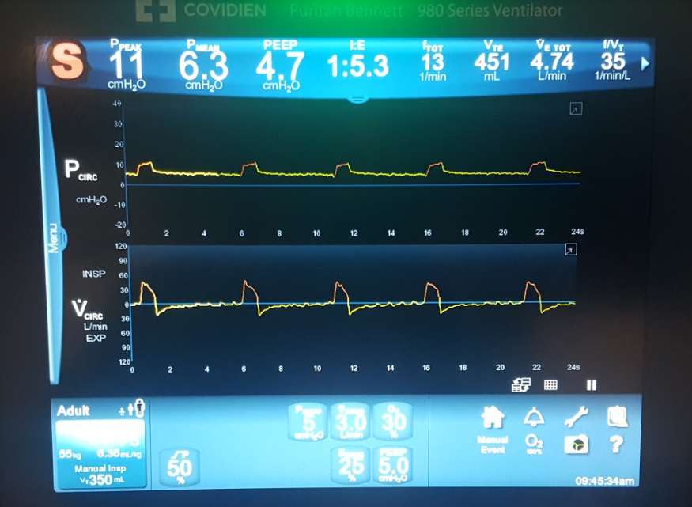
Passing an SBT
Able to oxygenate and ventilate without the ventilator
Rapid shallow breathing index (RSBI) of <105
Ask yourself – Does the patient look comfortable with stable vital signs?

Slide 50
Spontaneous Awakening Trial (SAT) and Spontaneous Breathing Trial (SBT)

Slide 51
When to extubate?
Requirements for extubation:
  Hemodynamic stability
  No planned procedures
  No need for frequent suctioning
  Able to protect airway, good mental status
  Cuff leak (ask an RT)
  Able to ventilate and oxygenate without the ventilator
    Passed an SBT

Slide 52
Extubation in COVID-19 Patients
Favor HFNC with humidity for immediate post-extubation supplementation
Trial of NIV with full face mask and filtered exhalation port may be considered in select cases (i.e. COPD)
If trach, trach collar trial with in-line suction or filtered heat moisture exchanger

Slide 53
Patient/Family Engagement, Visitation, and End of Life Care

Slide 54
Visitor Policy
No visitors are allowed
  End-of-life care exception possible (talk to nurse manager/charge nurse)

Slide 55
Surrogate Decision Making and Family Communication
Identify healthcare POA or healthcare surrogate per routine
Always identify a secondary agent in case primary is not available
Designate a single contact person that will be updated by the team daily
  If deemed appropriate facetime and video chat may be acceptable/preferred (difficult to have end of life conversations over phone)
  iPads soon to be available to facilitate communication

Slide 56
Recommended Timing of Communication

Slide 57
Cardiopulmonary Resuscitation
We DO NOT have a universal DNR policy
The following recommendations do not replace clinical judgment
Unexpected cardiac arrest: sudden development or cardiac failure in the setting of improving/stabilized pulmonary disease
  CPR SHOULD be performed if consistent with patient preferences/code status
Expected cardiac arrest: progressive hemodynamic deterioration refractory to maximal intensive care, clear that CPR is unlikely to be successful
  CPR SHOUD NOT be performed
  Must document why CPR will have no reasonable chance of success in medical record
  Notify the family that CPR will not be performed

Slide 58
Ethics and Allocation
If decisions must be made for allocation of resources among 2 or more people who could benefit, consult NM Allocation Decision Making Team
  ethics@nm.org
  Pager: 312-921-3343

Slide 59
Thank You
Division of Pulmonary and Critical Care Medicine
Editors: Khalilah Gates, MD
Clara Schroedl, MD

