Slide 1
Sedation and Analgesia Division of Pulmonary and Critical Care

Slide 2
Sedation versus Analgesia: not synonyms!
Patients in the ICU often experience pain, anxiety, and agitation.
Sedatives and analgesics are often used together, but do not have to be!
Many analgesics have some sedative effects, but most sedatives do NOT have analgesic effects.
Nurses are excellent resources for assessing and optimizing pain control and sedation
Sedation:
Reduces level of awareness
Produces amnesia
Eases agitation
Analgesia:
Reduces sensation of pain

Slide 3
Pain in the ICU
Pain is the most common memory patients report about their ICU stay
Procedures are a common cause of pain, but don’t forget how uncomfortable routine management to be: turning patients, suctioning, etc.
Pain is a very common driver of agitation in the ICU. Therefore, pain should be treated before increasing sedation.
Although infusions are common, PRN boluses are a great option if needs are low or episodic
Assess pain with the CPOT!

Slide 4
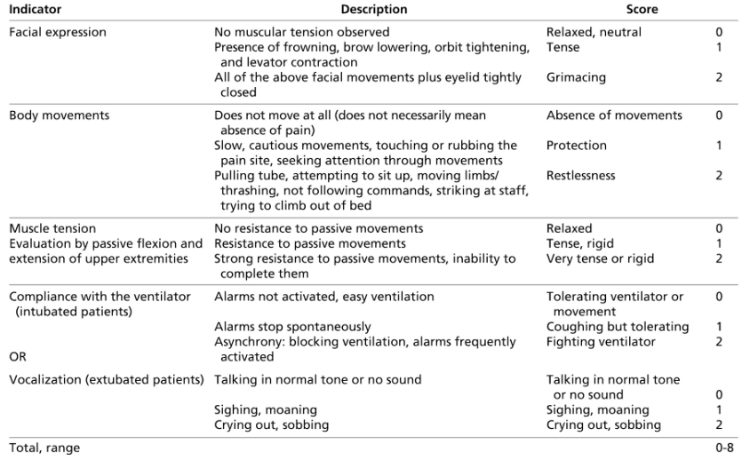
Assessing Pain: CPOT (typically assessed by nurse)
(Payne et al Anesthesiology 2009)

Slide 5
Medications for Pain Management
DRUG | EQUIVALENT IV DOSE | STARTING DOSE | ONSET | SIDE EFFECTS
Fentanyl | 0.1mg | 25-50 mcg/hr | 1-2 min | Less hypotension than with morphine Constipation, nausea, resp depression
Hydromorphone (Dilaudid) | 1.5mg | 0.5 mg/hr | 5-15 min | Constipation, nausea, resp depression
Morphine | 10mg | 2-30mg/hr | 5-10 min | Possible histamine release Constipation, nausea, resp depression
*Ketamine (NMDA antagonist) | N/A | 2-8 mcg/kg/min | 1-5 min | Alternative in cases of opioid induced hyperalgesia Higher doses have sedative effects
Gabapentin | For neuropathic pain

Slide 6
Sedation in the ICU
Our goal is for all patients to be awake, calm and interactive.
However, many patients develop agitation and delirium which can be dangerous to them. Risks include:
Self-extubation
Removing lines
In severe respiratory failure, as may happen with COVID-19, deep sedation may be indicated to ensure patients are synchronous with the ventilator.
Before neuromuscular blockade can be initiated, patients must be deeply sedated.

Slide 7
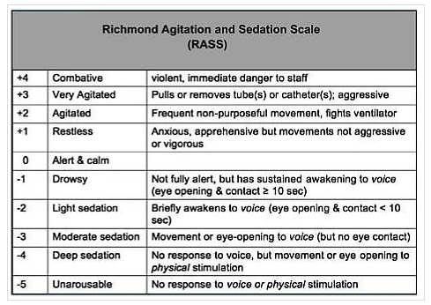
Assessing Sedation: the RASS Scale

Slide 8
Medications for Sedation
Drug | Mechanism of Action | Dosing | Advantages | Disadvantages
Propofol | GABAa | 50-200 mg/hr | Fast onset (1 min) , fast off | Hypotension Pancreatitis Infusion syndrome HyperTG
Dexmedetomidine (Precedex) | a2- agonist | Half life of 2 hrs 0.2 - 1.5 mcg/kg/hr Use for <24 hrs | Some analgesia properties | Hypotension Bradycardia Dry Mouth Nausea
Benzodiazepines Ativan Midazolam | GABAa | 1 - 5 mg/hr | Less hemodynamic effects Good in EtOH withdrawal | Higher risk of delirium Tolerance

Slide 9
Pain Management Protocol-Medication Adjustment

Slide 10
Sedation Protocol-How to adjust meds

Slide 11
Weaning Sedation
Too much sedation can worsen delirium and lead to longer days on a ventilator and longer total hospital stays
Daily spontaneous awakening trials (Kress et al, NEJM, 2000) have been repeatedly shown to improve care in the ICU.
Procedure is simple: simply stop all sedatives and wait for patient to wake up
Allows for accurate assessment of pain and agitation
Often shows patients can tolerate lower doses of sedatives

Slide 12
Spontaneous Awakening Trial (SAT) and Spontaneous Breathing Trial (SBT)

Slide 13
Analgesia and Sedation in COVID-19 Infection
We have found patients with COVID-19 infection who are intubated often require deep sedation.
This is likely due to high ventilator requirements and severity of respiratory failure:
Asynchrony with the ventilator can worsen hypoxemia
Proning can be uncomfortable
Our first line therapy has been fentanyl and propofol infusions, with exceptions for particular clinical circumstances.

Slide 14
Assessing Delirium in the ICU with CAM-ICU

Slide 15
Delirium-Diagnosis and Treatment
Key features of delirium
Disturbance in attention and awareness
Disturbance develops over a short period of time (hours to days), is a change from baseline, and tends to fluctuate
Additional disturbance in cognitive ability (memory deficit, disorientation, language, visuospatial ability, or perception)
Disturbances without alternate neurocognitive disorder
Clinical evidence that medical condition is contributing
Always evaluate for medical etiologies, like ETOH withdrawl
Drug toxicity
Metabolic disorders
Infections
Patients with delirium have a higher mortality than those without

Slide 16
Delirium Treatment
Prevention
Orientation
Early mobilization
Facilitation of sleep
Visual and hearing aids for impairments
Pain management
Management
Treatment of underlying conditions
Supportive care
Risperidone/Haldol
Seroquel

Slide 17
Summary
Analgesia and sedation are not the same
Pain should be assessed (CPOT) and treated (opioid medications)
Sedation should be assessed (RASS scale) and treated – ideally with propofol or dexmedetomidine
Daily reassessment of need for analgesia and sedation should be performed, and medications should be weaned whenever possible.
Delirium in the ICU should be assessed daily
use of CAM-ICU or other delirium scale with minimization of sedation as much as possible

Slide 18
Thank You

Slide 19
Special Thanks To:
Joseph Bailey, MD
Khalilah Gates, MD
Clara Schroedl, MD

