Slide 1

The Patient Centered Outcomes Research Institute (PCORI):
Working Through The Maze of a New Research Opportunity
David Cella, PhD
Zeeshan Butt, PhD
Center for Patient-Centered Outcomes
Institute for Public Health and Medicine
Northwestern University Feinberg School of Medicine
IPHAM Wednesday Workshop
May 29, 2013

Slide 2


Slide 4
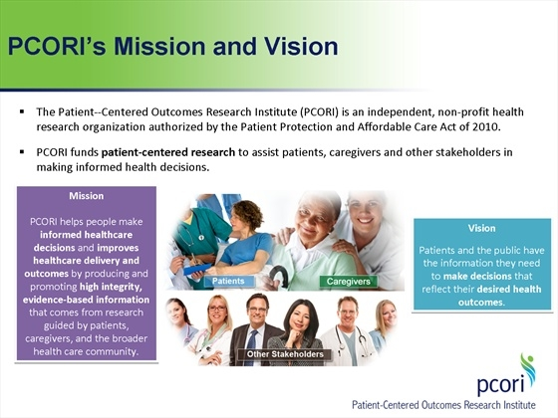

Slide 6
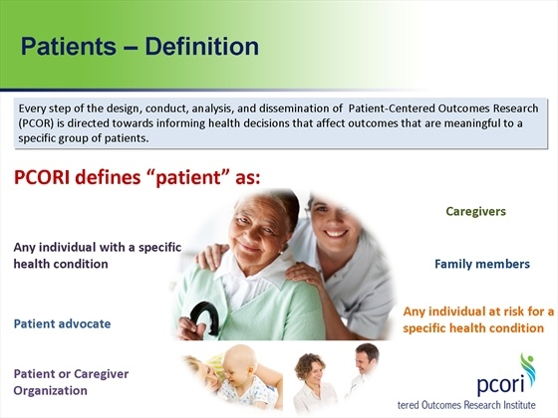

Slide 7
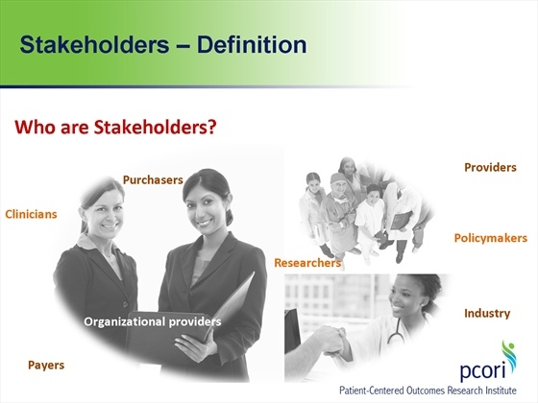

Slide 8
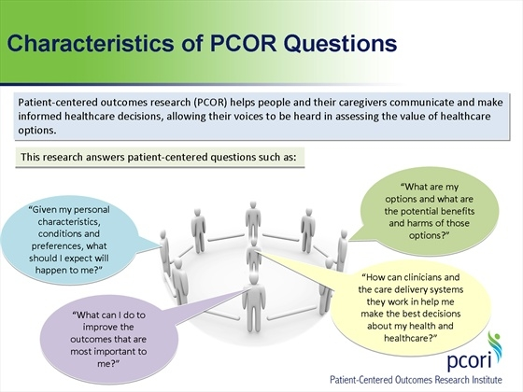

Slide 9
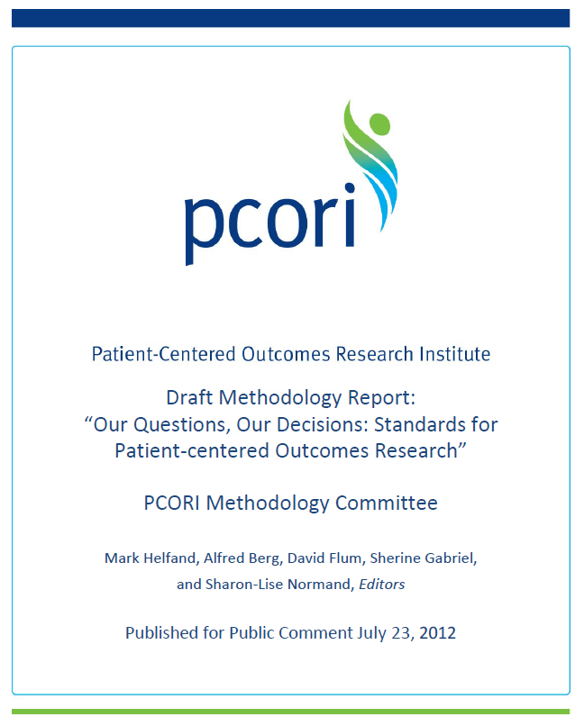
Methodology Report
  Submitted to the PCORI Board of Governors on May 10, 2012
  Accepted by the PCORI Board of Governors on May 21, 2012
  A public comment period on the draft report: Through September 14 2012
  Revisions were approved by the Board of Governors November 2012
9
Notes:
Steve
The first methodology report was specifically required by the legislation that created PCORI, as we stated earlier.
The MC submitted a draft report to the Board of Governors in May. The board accepted the draft and we are now asking for public comment.
We want and need input….and based on that as well as ongoing review by the Methods Committee the report will be revised and a final version will be submitted to the Board in November.

Slide 10
Assessment of Prevention, Diagnosis, and Treatment Options

Slide 11
PCORI AND FSM
Three awards to date
  Butt: PROs for PCOR – literature review and survey
  Heinemann: PRO Quality Metrics for Rehabilitation
  Lindquist: Advance Planning for Senior Home Services

Slide 12

Developing Quality Metrics from Patient-Reported Outcomes for Medical Rehabilitation
Allen Heinemann, PI
Karon Cook, co-I
David Cella, co-I
Anne Deutsch, co-I
Julie Schwertfeger, co-I
Contract funded under PCORI’s Communication and Dissemination Research Portfolio
Notes:
This project was funded as a contract under PCORI’s Communication and Dissemination Research announcement.

Slide 13
Specific Aims
Identify issues that are important to the quality of care for rehabilitation patients that are amenable to the collection of patient-reported outcomes
Evaluate the feasibility of collecting PROMs
Specify items required for quality measure development and design data collection modules that can be used in quality improvement efforts and to demonstrate accountability of health care delivery
Notes:
The scope of work reflects the talent and experience of the team:
Allen Heinemann – broad rehabilitation outcomes experience
Anne Deutsch – quality measurement work with the National Quality Forum and prior funded work on quality measures for stroke patients
David Cella– leadership in IRT/PROM development
Karon Cook – psychometric expertise
Julie Schwertfeger – clinical manager at Alexian Rehabilitation Hospital, large suburban rehabilitation program

Slide 14
Mixed Methods Design
Focus groups
Key informant interviews
Primary data collection with a sample of 300 neurorehabilitation patients

Slide 15
Advisory Committee
Represents key stakeholders
  Patients
  Patient advocacy organizations
  Clinicians
  Professional associations
  Policy makers
Role: Provides key input throughout the study by identifying
  Relevant quality concepts for inpatient rehabilitation facilities
  Instruments that best operationalize these concepts,
  Priorities for quality measures for rehabilitation patients
  Quality measures that can be derived from PROMs that are appropriate for rehabilitation patients and fulfill NQF’s quality measure criteria
  Case mix factors

Slide 16
Advanced Planning for Home Services for Seniors –
Funded PCORI
Lee Lindquist, MD MPH MBA,
Clinical Practice Director - Geriatrics
Division of General Internal Medicine and Geriatrics

Slide 17
Aims
Aim 1: Develop an Advanced Planning for Home Services (APHS) Tool to assist seniors in making informed choices about issues in their health trajectory that influence their ability to remain in their own home.
Aim 2: Conduct RCT of the APHS Tool
Aim 3: Disseminate the APHS Tool nationally through senior focused organizations (Home Care Association of America, Village to Village Network).

Slide 18
Strengths
Focused on seniors who had chronic/complex medical issues.
Outcomes are patient-centered.
Able to be disseminated quickly and easily through national senior community and home care groups (with representatives as paid stakeholders all years).

Slide 19
Tidbits I heard and included:
“Pay your stakeholders” - Stakeholders paid as consultants/co-investigators ($10K per yr.)
Make sure to highlight who are the stakeholders and that they are actual patients (support letters, within grant, and CV of patients)
The more patient-centered the better.
Programmatic travel is different than conference travel ($2000) and state directly.

Slide 20
YEAAAAA!!!
The Advance Planning for Home Services Tool will be developed by seniors, tested by seniors, for use by seniors with the guidance of university based researchers.

Slide 21
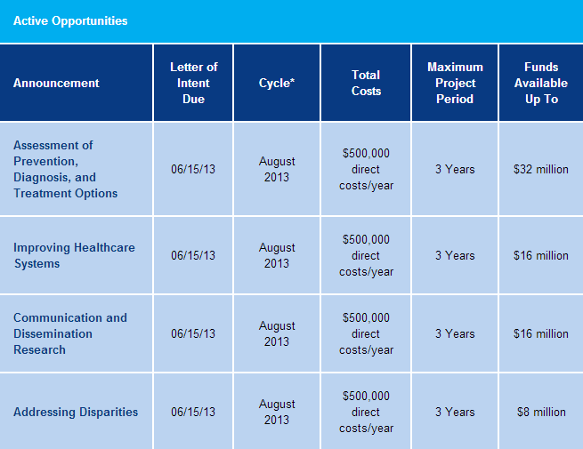
10/15/13 Dec 2013
02/15/14 Apr 2014
10/15/13 Dec 2013
02/15/14 Apr 2014
10/15/13 Dec 2013
02/15/14 Apr 2014
10/15/13 Dec 2013
02/15/14 Apr 2014
Note: The LOI is non-binding with respect to science or budget; however, you must request permission for proposals that exceed yearly direct cost caps.

Slide 22
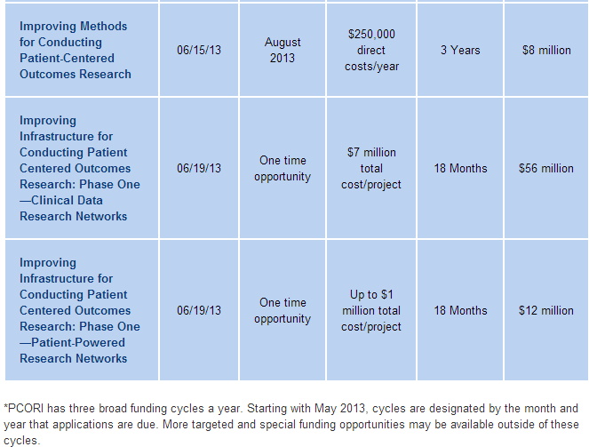
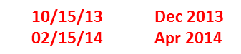

Slide 23
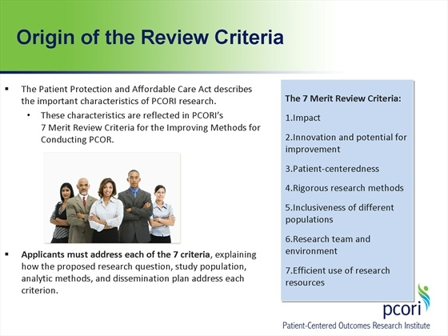

Slide 24
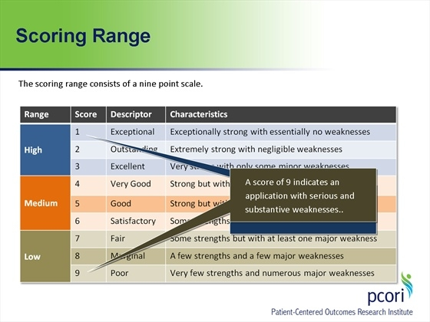

Slide 25
PCORI Review Criteria

Slide 27
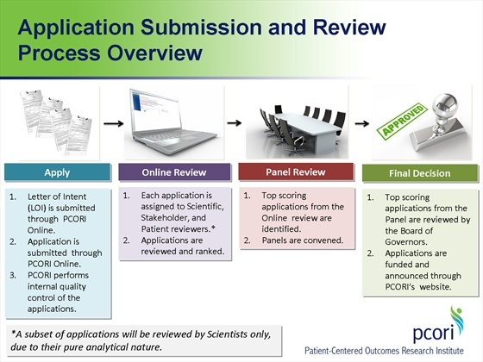

Slide 28

A few cautionary notes:
  PCORI is interpreting this mandate VERY strictly
Patients and other Stakeholders
Read and re-read the PCORI Methodology Report
Ask PCORI questions
Subscribe to the PCORI listserv

Slide 30
PCORI Part 2
June 19, 12-1 pm
Clyde Yancy, MD
  Professor of Medicine (Cardiology)
  Member PCORI Methodology Committee

Slide 31
Questions?
David Cella, PhD
d-cella@northwestern.edu
312-503-1086
Zeeshan Butt, PhD
z-butt@northwestern.edu
312-503-7708
Center for Patient-Centered Outcomes
Institute for Public Health and Medicine
Northwestern University Feinberg School of Medicine
IPHAM Wednesday Workshop
May 29, 2013

