Slide 1
Scientific Writing and Publishing
Phil B. Fontanarosa, MD, MBA

Slide 2
Disclosures
Full time editor at JAMA, 1993-2022
No current employment, financial, or contractual relationship with JAMA or the AMA, the publisher of the JAMA Network Journals
Co-Editor, Principles of Scientific Writing and Biomedical Publication, 2024
No royalties, compensation, or payments from book sales or licenses

Slide 3
Scientific Writing and Publication Workshop
Two main topics
1. Manuscript Preparation
2. Interacting with Journals
* As workshop – focus on practical suggestions *
Journals are examples; not meant as endorsement
Most data from journal websites, information for authors

Slide 4
Manuscript Preparation
Overarching Goals of Manuscript Preparation
  Prepare quality manuscript efficiently and effectively
  Increase likelihood of publication
Workshop Discussion - Some key factors helping to achieve goals with manuscript preparation
  Offer practical suggestions
  Factors / data that may help inform these topics
  Thoughts on common issues/problems that arise
  Will focus on 8 selected topics / “habits”

Slide 5
1. Develop an Effective and Efficient Writing Strategy
Many effective authors have efficient writing strategies
Life will most likely get busier
  Professional demands, clinical demands, research demands, family demands
Need for scholarly output most likely will increase
  Expectation for Publications, grants
Will have less time, but will need to be more academically productive
Importance of having effective, efficient writing strategies and habits

Slide 6
Develop an Effective Writing Strategy
“Writing is easy. All you have to do is sit staring at a blank sheet of paper until the drops of blood form on your forehead.” Gene Fowler
For some, scientific writing is hard work.
High-quality scientific writing is not a task that can be performed easily or simply ‘fit in’ with other tasks and responsibilities.
Importance of having effective strategies

Slide 7
Strategies for Scientific Writing
Pre-Writing Considerations
Know the topic thoroughly
Determine the main message and frame of the manuscript (explain in a single sentence)
Decide the reasons the manuscript is being written
(novel findings, increment of new information, verification of other studies, difference from other reports or reviews, timeliness of topic)
• Objectively assess the importance of the report

Slide 8
Strategies for Scientific Writing
Overcome Procrastination
Procrastination – interferes with efficient writing and timely manuscript preparation
Understand common causes of procrastination
  Distractions – other tasks, easier/fun activities
  Difficulty with focus due to other time demands or competing priorities
  Writing may be perceived as work – feels like a grind; perhaps stressful to produce
  Emotion – possibly could conjure unpleasant thoughts if prior difficulty, criticism of work

Slide 9
Strategies for Scientific Writing
Addressing Procrastination
Some suggestions to address procrastination:
Make a commitment to write the manuscript in a reasonable timeframe
Establish realistic, but timely deadlines
Establish target dates for each section and for manuscript completion and submission
If possible, write something every day
Regular meetings, discussions, updates with co-authors – to motivate / incentivize progress

Slide 10
Strategies for Efficient Scientific Writing
Find the Scientific “Writing Zone”
“In the zone” - athletes, musicians - peak performance
Writing zone – state of flow of ideas, hyper-focus, almost effortless, most efficient writing
Find most creative, most productive time
If possible, write when energy is high, not when tired
Find most productive environment
  atmosphere, background, setting
Find most effective writing format
  Electronic / paper and pen / dictation
Schedule time for writing, if possible

Slide 11
Strategies for Scientific Writing
Effective Writing Sessions
Goal – maximize efficiency during writing sessions
Have all materials at hand (data, references)
Eliminate distractions
  Turn off cell phones / pagers (if possible)
  Don’t check e-mail (Facebook, Twitter/X, etc, etc)
  Don’t interrupt writing to search for new information
Don’t insist on perfect sentences or paragraphs
“Write badly” [per Karen Russell] – especially 1st draft
Initial focus on ideas, less concern about sentence structure / grammar / spelling /typographical errors

Slide 12
Strategies for Scientific Writing
Importance of the Outline
Writing the first draft
Start with working title
Develop a detailed outline
  Manuscript format / sections
  Reporting guideline framework for structure
  Fill in sections – terms, phrases, sentences
*Provides check on internal logic of manuscript
*Provides mechanism for obtaining feedback from co-authors
Relatively easy to move from outline to manuscript
  Bullet points to sentences; sentences to paragraphs

Slide 13
Strategies for Scientific Writing
Deconstruct the Manuscript
Deconstruct the manuscript into sections
Consider each section as a separate task
Focus on one task at a time
Write “easiest” sections first
Establish reasonable, achievable deadlines for each section

Slide 14
Research Report Format
NEJM and JAMA ‘audit’ – 2023
Recommend word count: NEJM 2700; JAMA 3000
Title
Abstract 250-350 words
Introduction 2-3 paragraphs
Methods 6-10 paragraphs
Results 6-8 paragraphs
Discussion 8-10 paragraphs
Conclusion 1 paragraph
References 30-40
Tables 2-3
Figures 2-3

Slide 15
Strategies for Scientific Writing
Document Management
Reference all source materials meticulously
  Avoid searching / repeat searching for sources
Consistent use of reference management software
Keep copies of all sources (especially urls)
Manuscript Versions - number / date for all drafts, all pages, all electronic files
Develop familiar, consistent nomenclature for naming drafts
  Managing “track changes” versions vs “clean” versions
  Managing / naming documents with comments from co-authors

Slide 16
Strategies for Efficiently and Effectively
Working with co-Authors
Establish mutually agreeable timelines
Agree on assignments / responsibilities
Assume a “coordinator” role
Be politely persistent
Obtain feedback on your sections
Obtain / provide feedback on others’ sections
Proceed quicky with revisions as needed after co-author input

Slide 17
2. Select Target Journal Early
> 40,000 science, technology, and medical journals published worldwide
> 5,200 journals indexed in Medline
Journal selection key for framing the manuscript
Manuscript format varies widely by journal
Manuscript tone, focus, terminology vary by journal audience, likely readership
  eg, specialized journals - more technical terminology, language
  eg, general journals - more explanation of concepts / terminology, more accessible language

Slide 18
Journal Selection Considerations
General vs specialty vs subspecialty
Circulation / reach / publication frequency
Reputation / prestige / professional influence
Manuscript submissions / Acceptance rates
Turnaround times – to review, to publication
Innovation – print, website, digital
Traditional vs Open Access publishing model
Article downloads / Library usage
Media coverage / social media presence

Slide 19
Journal Selection Considerations
Impact Factor
Idea developed in 1955
Published by Clarivate Analytics as Journal Citation Reports
Widespread use, somewhat controversial
Proxy for relative importance of a journal within a field
Used to judge journals, research, authors
Just one of many journal metrics

Slide 20
Journal Impact Factor
Journal Citation Reports
Tracks citations in > 12,000 active journal titles and > 3000 proceedings and volumes
Relates the citations in these sources (eg, journals) to articles published in the same or other journals
IF - Calculated as - ratio of citations to articles

Slide 21
Journal Impact Factor Calculation
2023 data as example
NUMERATOR: # of citations (from the same or other journals) to articles in an individual journal that occur during a calendar year [2023], with these citations to articles that were published in that journal in the previous 2 years [2022 and 2021]
Note: Includes citations to virtually all types of articles in the journal, including research articles, reviews, letters to the editor, research letters, and opinion articles (such as editorials, commentaries, viewpoints, perspectives, etc.),
DENOMINATOR: # of “countable” articles (mostly research articles and long reviews) published in the journal in the previous 2 years [2022 and 2021]

Slide 22
Impact Factor Data – 2020-2023
2020 2021 2022 2023
Lancet 79.3 202 169 98.2
NEJM 91.2 176 158 96.2
JAMA 56.3 157 121 63.1
BMJ 39.9 93.3 105 93.6
Nat Med 53.4 87.2 82.9 58.7
Nature 49.9 69.5 64.8 50.5
Cell 41.6 66.8 64.5 45.5
Science 47.7 63.7 56.9 44.7
Ann IM 25.4 51.5 39.2 19.6
Note – Impact Factor for 2024 – will be released June 2025

Slide 23
Impact Factor –2023 - Selected Journals
Am J Public Health 9.6
Annals EM 6.6
Academic EM 3.4
JMIR 7.4

Slide 24
Journal Selection Considerations
Social Media Presence
  Many journals - active social media presence
  Common way to amplify article and increase reach and visibility
  May request authors to submit potential posts for accepted manuscripts
  Facebook, Instagram, X (aka Twitter), etc
  Some journals list social media activity with each article (eg “Tweetations” - J Medical Internet Research)

Slide 25
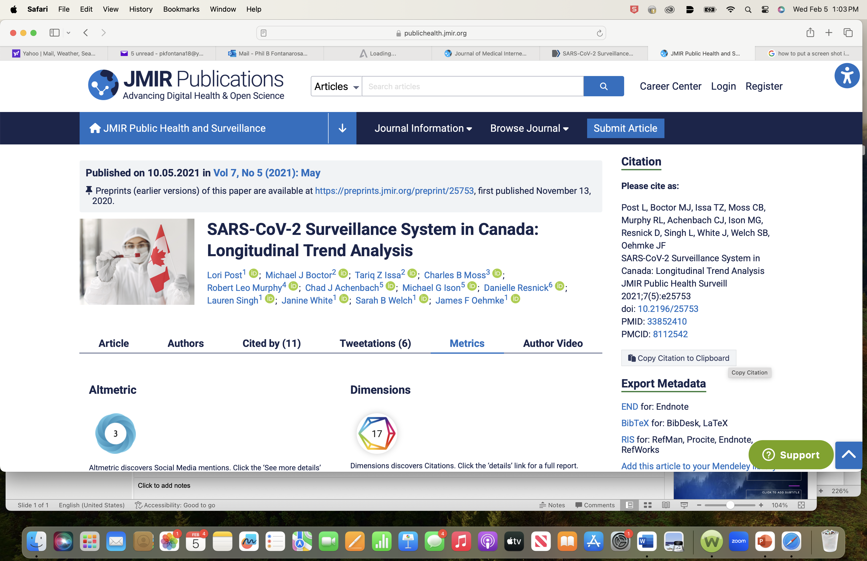

Slide 26
Journal Articles and On-line Attention
Some journals track “Alternative metrics” of on-line interest (accumulates more quickly than citations)
Altmetric – data science company
  “Online Attention Tracker”
Measure of article dissemination in various sources
  Tracks mentions in news stories, blogs, social media, pageviews, downloads, videos, Youtube, etc
Some journals embed Altmetric scores / ‘badge’ with articles (NEJM, JAMA, AJPH, JMIR, others) and may show changes in interest levels over time

Slide 27

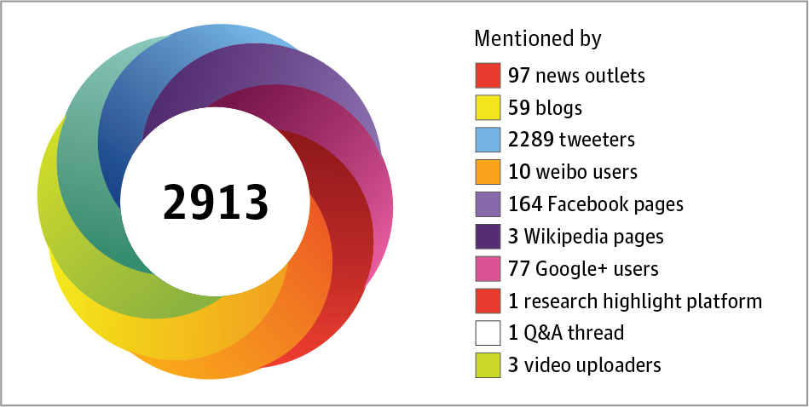
From: The Rise of Altmetrics
JAMA. 2017;317(2):131-132. doi:10.1001/jama.2016.18346
The Altmetric DonutThe Altmetric donut illustrates the dissemination of a research output through different channels. Each colored stripe represents a different platform on which the work was mentioned. The central number is the Altmetric score.

Slide 28
Journal Selection Considerations
Manuscript – related Factors
Match focus / message of manuscript with target journal, considering target audience
Recent articles on similar topics / issues
Compare methods (eg, RCTs, MAs)
Compare scope (eg, sample sizes, multi-center)
Potential “fit” with specific journal section
Websites – suggest journal, based on title/abstract
  JANE – Journal/Author Name Estimator
  ThinkCheckSubmit

Slide 29
Journal Selection – Practical Considerations
Acceptance Rates and Author Fees
Acceptance rates (overall)–
  Lancet (‘about 5%’); NEJM (‘about 5%’);
  JAMA (12%; 4% for research); Acad EM (18%);
  AJPH (13.7%; 4% for research); JMIR (50%)
Author fees – Article Publishing Charges (APCs) for Journals with Open Access Publication Option
  Lancet $7,890; AJPH $2,500
  Ann EM $3,850; Acad EM $3,900; JMIR $3,350

Slide 30
Journal Selection Considerations
Aim for higher profile journal first, with tradeoff of lower acceptance rate and possible delay ?
OR Select journal deemed to represent best chance to acceptance and publication, and potentially avoid delay ?
Reputation for / actual author “friendliness”
Previous interactions / relationships with journal

Slide 31
3. Determine Manuscript Format
Full-length Research Report
Brief report / Research Letter
Review article
Opinion piece (Viewpoint, Perspective, Commentary, Editorial)

Slide 32
Manuscript Preparation –
Determine Manuscript Format
**Consult “information for authors” of target journal **
Provides details on manuscript types and formats
  Length (overall and by section)
  Format and stylistic elements
  Required elements and information
  Journal policies and procedures
Model the manuscript to be consistent with articles published in the target journal

Slide 33
Research Manuscript Format
NEJM - Maximum length: 2,700 (excluding title, abstract); Maximum - 5 tables and figures, Up to 40 references - “Manuscripts far exceeding word-count limits will be returned unread.”
JAMA - Maximum length: 3,000 words of text (excluding abstract, tables, figures, references) No more than a total of 5 tables and/or figures.
Lancet - up to 3,500 words (4,500 for RCTs) for manuscript text with up to 30 references. Must include a Research in Context Panel - evidence before this study; added value of this study; implications of all available evidence

Slide 34
Research Manuscript Format
AJPH - Up to 3,500 words of text; up to 4 tables and figures combined, and no more than 35 references; section on Public Health Implications.
Ann EM - maximum 3,250 words; 7 tables and/or figures.
Acad EM – 5,000 words; no more than 5 tables and no more than 5 figures
JMIR - “no maximum word count”; fees apply if word count exceeds 10,000; No more than 5 tables and no more than 8 figures

Slide 35
4. Develop an Effective Manuscript Title
“Working” / draft title for manuscript
Helpful to crystallize key concept and focus
Not necessarily the final title
  Last Man in Europe -> 1984 (Orwell)
  The Sea Cook -> Treasure Island (Stevenson)
  Pansy -> Gone with the Wind (Mitchell)
  All’s Well that Ends Well -> War and Peace (Tolstoy)
  Prometheus Unchained -> Frankenstein (Shelly)

Slide 36
Develop an Effective Title
“Headline” of any report
First entrée point to an article
Accurate, succinct
Include primary concept / key term
Illustrates the key concept that permeates the article
Must be identifiable in literature searches
Attract attention, not “gimmicky”; never trivializing
Generally, not declarative (depends on journal)
Generally, not a question (depends on journal)

Slide 37
Effective Titles
Possible Formats:
Exposure -> outcome in population
Inference consistent with study design
“Effect of X on Y among patients with Z”
“Association between X and Y among patients with Z”
X [intervention or exposure] and Y [outcome] in Z [population]
Goals - Clear, logical, unambiguous, descriptive

Slide 38
Research Title Format - Subtitles
  Should complement the main title
  Inclusion of methods / study design
    A randomized trial; A meta-analysis
  Inclusion of trial / study name
    The Women’s Health Initiative Randomized Trial
    An Analysis from the Flexibility in Duty Hour Requirements for Surgical Trainees (FIRST) Trial
  Inclusion of data source
    Results from the National Health and Nutrition Examination Survey

Slide 39
Effective Titles
Titles of research reports – generally scholarly, formal, scientific
Titles of editorials and opinion articles
  A bit more latitude
Types of Titles / Subtitles to Avoid:
  “Pansy– like” titles
  Cliches - “One size does not fit all”
  “To screen or not to screen – that is the question”

Slide 40
Journal Style for Titles
Wide variation by journals in terms of style and format for titles
Different title types for different article types (research, opinion, news, letters, etc)
Model manuscript title after titles of similar articles in target journal

Slide 41
Selected Sample Titles
NEJM – January 2025
Transcatheter Aortic -Valve Replacement for Asymptomatic Severe Aortic Stenosis
Fracture Prevention with Infrequent Zoledronate in Women 50 to 60 Years of Age
Asymptomatic Severe Aortic-Valve Stenosis — To Wait or Not to Wait (editorial)
Infrequent Zoledronate — Small Individual Gain, Larger Population Gain (editorial)

Slide 42
Selected Sample Titles
JAMA – January 2025
Early Intervention in Patients with Asymptomatic Severe Aortic Stenosis and Myocardial Fibrosis: The EVOLVED Randomized Clinical Trial
Expanded Newborn Screening Using Genome Sequencing for Early Actionable Conditions
Myocardial Fibrosis and Timing of Intervention for Aortic Stenosis [editorial]
The Path to Genomic Screening—Far from Simple, but the Journey Has Begun (editorial)

Slide 43
Selected Sample Titles
Lancet – January 2025
Trans-arterial chemoembolisation combined with lenvatinib plus pembrolizumab versus dual placebo for unresectable, non-metastatic hepatocellular carcinoma (LEAP-012): a multicentre, randomised, double-blind, phase 3 study
Appendicectomy versus antibiotics for acute uncomplicated appendicitis in children: an open-label, international, multicentre, randomised, non-inferiority trial
Antibiotics alone versus appendicectomy for uncomplicated appendicitis in children (editorial)

Slide 44
5. Develop an Informative, Quality Abstract
Abstract - prominent position in the article
Represents an overview of the study / report
Provides a summary of the study design
Reports actual data for main results
Makes key findings of the article readily available, such as in literature searches
Provides a clear “take home” message
May include caveats

Slide 45
Research Manuscript Format - Abstract
Important entry point in manuscript evaluation
May shape the impressions of editors and reviewers
  High-quality, well-written, detailed abstract - may signal that the same quality will follow throughout the full manuscript
  Low-quality, poorly written, incomplete abstract - may create negative initial perceptions about the manuscript
Ensure abstract is accurate, complete, and carefully prepared

Slide 46
Research Manuscript Format - Abstract
Review journal instructions and published articles to determine abstract structure, format, standards, and stylistic elements
** Use correct journal abstract format
Failure to follow format may suggest:
  author is not familiar with the journal
  author lacks appropriate attention to detail
  manuscript already been submitted to another journal and rejected.

Slide 47
Research Manuscript Format - Abstract
  NEJM abstract – “four-part” - Background, Methods, Results, and Conclusions, length < 250 words.
  Lancet abstract - Background, Methods, Findings, Interpretation, and Funding, length < 300 words.
  JAMA abstract - “multi-part” - Importance; Objective; Design, setting and Participants; Main Outcomes and Measures; Results; and Conclusions and Relevance, length < 350 words.

Slide 48
Research Manuscript Format - Abstract
  Annals EM abstract - Study hypothesis or Objective, Methods, Results, Conclusions;
  250 words or less
  Academic EM abstract - Objectives, Methods, Results, Conclusions; 300 words or less
  AJPH abstract – Objectives, Methods, Results, and Conclusions; 180 words or less; A fifth heading, Policy Implications, is recommended if not platitudinous

Slide 49
Research Manuscript Format – Abstract
Some common issues
Including information in abstract that is not in the full manuscript
Inconsistency between information reported in the abstract and in the full manuscript
Failure to state a clear objective and the study design
Lack of detailed data for the study population and main outcomes (absolute numbers or rates with measures of uncertainty)
Conclusions not directly supported by study findings / interpretation extrapolated beyond study inferences

Slide 50
Abstract - Effective Conclusion
“Bottom line” of the study or report
Should ‘answer’ research question or objective
Must follow directly from results
Clear, appropriately succinct, circumspect
Avoid editorializing, platitudes, and clichés
Language consistent in 3 places in article – abstract conclusion, first paragraph of discussion, article conclusion (promotes internal consistency)

Slide 51
Effective Conclusions
Possible Format
“PICO” - Participants, intervention, comparator, outcome
  “Among patients with Z, exposure to A, compared to exposure to B, was associated with improved XX [outcome].” [Example of observational study]
“D-PICO-T” - Design, patients, intervention, comparator, outcome, time
  “In this multicenter clinical trial among patients with Z, treatment with A, compared to treatment with B, resulted in XX [outcome] at 2 years.” [RCT Example]
  ⦁ May need additional sentence for caveats

Slide 52
Sample abstract conclusions
> NEJM – “Among patients with asymptomatic severe aortic stenosis, a strategy of early TAVR was superior to clinical surveillance in reducing the incidence of death, stroke, or unplanned hospitalization for cardiovascular causes.
> JAMA – “In asymptomatic patients with severe aortic stenosis and myocardial fibrosis, early aortic valve intervention had no demonstrable effect on all-cause death or unplanned aortic stenosis–related hospitalization. The trial had a wide 95% CI around the primary end point, with further research needed to confirm these findings.”
> Lancet (Interpretation) – “Based on cumulative failure rates and a 20% non-inferiority margin, antibiotic management of non-perforated appendicitis was inferior to appendectomy.”

Slide 53
Sample abstract conclusions
Annals EM : “Tranexamic acid administration was not associated with either death or poor neurologic outcome. Prospective clinical trials of TXA usage in children with severe TBI are needed. “
Academic EM: “The modified Geriatric Trauma Outcome Score model exhibited superior predictive ability and clinical utility compared to the original GTOS. Net benefit and decision curve analysis offer valuable complementary methods to calibration and discrimination indicators, comprehensively evaluating the clinical usefulness of prediction models and decision strategies.”

Slide 54
Sample abstract conclusions
AJPH: “Marked vaccine uptake disparities exist between privately and publicly insured pregnant people. Understanding structural barriers, particularly for Medicaid enrollees, is critical to improving maternal vaccine access.”
JMIR: “ChatGPT, as a representative large language model, is a viable tool for simulating standardized patients in medical assessments, with the potential to enhance medical training. By incorporating proper prompts, ChatGPT’s scoring accuracy and response realism significantly improved, approaching the feasibility of actual clinical use. Also, the influence of the adopted language is nonsignificant on the outcome of the chatbot.”

Slide 55
Visual abstracts

Slide 56
6. Create an inviting Introduction
  Clear and concise
  Justification for the paper
  Establishes novelty and originality
  Intriguing and inviting
  Establishes a prelude of what will follow and sets the tone for the manuscript
  “Inverted pyramid” or “funnel” approach
  Provides the “BIO” of the article – Background, Importance, Objective

Slide 57
Research Manuscript Format - Introduction
  Background – provides context for the issue or problem the study will address
  - scope of the problem
  - current estimates on incidence or prevalence
  Importance - establishes the need for the study
  - identify knowledge gaps or research gaps
  - support with selected key authoritative, current references (eg, major studies, USPSTF reports, authoritative Guidelines, etc)

Slide 58
Research Manuscript Format
Introduction
  Objective - study aim or purpose.
  Key focused question study designed to answer.
  Must be clear and unambiguously stated.
  “The objective of this study is to evaluate ….”
  Could be followed by a statement of the study hypothesis.
  “The study hypothesis is that …”

Slide 59
Research Manuscript Format Introduction - Some common issues
Failure to establish importance of /need for the study
Should not report data, summary of results, or the ‘answer’ to the research question (which would not be knowable until the methods are described, and results are reported)
Lengthy, rambling, disorganized text
Length and format vary by journal, but for many bioscience journals, introductions are brief –
250-300 words; < 10-15 references

Slide 60
7. Prepare Detailed, Well-organized Methods and Results Sections
Core of the manuscript
Basis for critical appraisal
Must be detailed and complete
Consistent framework for methods and results, helps to ensure internal logic of manuscript
No results in the methods section
No methods in the results section
All results must have methods on which they are based

Slide 61
Research Manuscript Format - Methods
“There should not be a madness to the Methods” (per Robert Golub, MD)
**Enough detail to replicate the study**
Consistent with prespecified protocols and statistical analysis plans
Organized, logical approach
  Preamble (study design, ethical statements)
  Participants
  Interventions or exposures;
  Outcomes
  Statistical methods

Slide 62
Research Manuscript Format - Methods
One approach - Begin with general description of study design and oversight
  “This phase 3, randomized clinical trial was conducted at 10 US sites. The institutional review board at each participating center approved the protocol. All patients provided written informed consent. An independent data and safety monitoring committee reviewed trial outcomes at prespecified regular intervals. The full protocol and statistical analysis plan are available in the online supplement.”

Slide 63
Research Manuscript Format - Methods
Reporting guidelines and standards
  Provide useful roadmap for logical organizational framework and for completeness of key elements
  EQUATOR Network (www.equator-network.org)
  659 reporting guidelines
  CONSORT (RCTs); STROBE (Observational);
  PRISMA (Systematic Reviews); TRIPOD (Diagnostic test/Prognostic studies)

Slide 64
Methods
CONSORT Guidelines
Trial design
Participants
Interventions
Outcomes
Primary
  Secondary
  Exploratory
  Post hoc
Sample size
Randomization
  Sequence generation
  Allocation concealment
Masking
Statistical Methods
  Primary analysis
  Secondary analyses
  Other analyses

Slide 65
Research Manuscript Format - Methods
Must be complete, detailed, and transparent
References to justify approaches / assumptions
May require technical language or jargon, but all terms should be defined at first use
All key variables should be explained
  eg, methods to obtain information on participant sex, gender, or both; or on participant race and ethnicity
  ie, self-reported, included in database, etc
  eg, methods to ascertain outcome variables
  ie, self-report, registry data, medical records, database

Slide 66
Research Manuscript Format - Methods
Statistical analysis section
Must be detailed and complete
Some common omissions
  Sample size and power calculations
  Basis for detectable difference
    MCID - minimally clinically important difference (with refs)
  Handling of missing data
  Details for addressing confounding
  Significance level (and if 1-sided vs 2-sided testing)
  Adjustment for multiple comparisons
  Statistical software and version

Slide 67
Research Manuscript Format - Methods
Err on the side of “More is better”
May need to include some detail in supplemental materials (depending on manuscript length limits)
See instructions for authors of target journal for guidance and review methods sections of published articles for examples of structure, rigor, and detail expected in methods section for that journal

Slide 68
Preparing the Results Section
Efficient with logical sequence
Objective presentation, no interpretation
Data speak for themselves
No results without methods
No methods in results section
“Just the facts” approach
Should follow framework established in methods
Consider framework for results in reporting guidelines (eg, Consort, Strobe, Prisma, etc)

Slide 69
Results – Possible organization
Describe study population
  Key demographic features (“Table 1”)
Data on participation / study completion
Missing data, adherence issues
Deviations from protocol
  eg, crossover, study stopped early
Consider flow diagram (“Figure 1”)

Slide 70
Results - Possible organization
Report data for outcomes
  Follow framework in Methods
Primary / Main outcomes presented first
  Directly related to primary study question
Secondary outcomes (if appropriate)
Tables and figures for key outcomes
Other outcomes
  Exploratory, sensitivity, post hoc
Adverse effects

Slide 71
Presenting Results -Tables and Figures
For most research reports, effective data presentation usually can be achieved with 4- 5 tables and/or figures
Flow diagram (depending on study design) – Figure 1
Baseline characteristics of study population / study groups – “Table 1”
Two elements (eg, 2 tables, 2 figures, 1 table/1 figure) showing quantitative results, with 1 table or figure illustrating primary outcomes
Table with adverse events, subgroup analyses, etc (depending on study design)

Slide 72
8. Prepare a Compelling
Discussion Section
For some authors, most difficult section to write
Should have natural, logical flow of ideas
Answers the question posed in the study objective
Explains how the results support the answer
Places findings in context
Explains importance, implications, limitations
Answers the ‘so what’ question

Slide 73
Discussion - Possible Organization
7 Key Ideas / Paragraphs
1.Summary of key study findings
  Similar to language in conclusion of abstract
  “In this randomized clinical trial of patients with XX, treatment with XX, compared to treatment with XX, resulted in XX, at 5 years.” (other outcomes, caveats)
2.Interpretation of findings
  “These results suggest ….
3.Compare with previous concordant literature
  “The finding from this study add to the evidence supporting …

Slide 74
Discussion
Possible Organization
4. Contrast with previous discordant literature
  “The findings from this study differ from those reported in some other studies.”
  Explain why differences (size, design, population, etc)
5. Explain implications
  Clinical, Research, Policy, Guidelines
    “The results of this study, together with previous findings from other studies, may have potential implications for …”
  Should be circumspect, not boastful
  Avoid overinterpretation, avoid editorializing
  Possible next steps in research – specific

Slide 75
Discussion - Possible Framework
6. Study Strengths
  “This study has several strengths…
7. Study Limitations
  ”This study has several limitations”
  Forthright acknowledgment of limitations (and how may have influenced results)
  Turn into ‘limitation-ade’ (if possible)
    “This study was conducted to a single site. However, …
    “ This study response rate was 58%. However, …
Conclusion - similar to conclusion in abstract, and first paragraph of discussion – “take home message”

Slide 76
Discussion - Common issues and problems
Does not focus on key study question
Overemphasis of findings from secondary, tertiary, subgroup, or post-hoc analyses
Too long, disorganized
Not objective or circumspect - “spin”
Excess editorializing (beyond the data)
Failure to thoroughly acknowledge limitations

Slide 77
Scientific Writing and Manuscript Preparation
Summary:
Importance of efficient scientific writing
Development of strategies / habits conducive to being a highly effective author

Slide 78
Interacting With Journals

Slide 79
Interacting With Journals
Communication should be effective and appropriate
Expectations of authors regarding editors
  Timely manuscript evaluation
  Clear, straightforward communications
  Objectivity and fairness in editorial decisions
  Confidentially regarding manuscript and information
Expectations of journal editors regarding authors
  Scientific integrity
  Honest, complete communications
  Disclosure of important information
  Timely response to questions and requests
Etiquette in interactions and professional tone for communications between authors and editors

Slide 80
Contacting Journals
Prior to Manuscript Submission
Pre-submission inquiries
  Ask journal about interest ? Suitability ?
*** Look in Instructions for Authors
Some journals – system for inquiries
  Brief letter and abstract
Some journals – require pre-submission authorization/approval for some article types
  (eg, reviews, ‘special’ articles)

Slide 81
Contacting Journals
Pre-submission Inquiries
NEJM
“Authors may complete a Pre-submission Inquiry form below to learn about the suitability of proposed manuscripts or to propose review article topics. An NEJM Editor will generally respond by email within one week.”
Requires author’s contact information, and may include an ‘Inquiry for the editor (250 words)” and a “Summary of the paper (250 words)”

Slide 82
Contacting Journals
Pre-submission Inquiries
The Lancet – “In almost all cases, if you have finished a manuscript, you should submit it, rather than contacting the Lancet to enquire whether an unseen manuscript is likely to be accepted.”
Annals EM - “If you have a manuscript that you would like to informally run by us prior to submitting, we respectfully request instead that you simply submit it. Annals has one of the fastest editorial turnaround times of all medical scientific journals, so this will provide the most accurate feedback in the shortest possible time.”

Slide 83
Contacting Journals
Pre-submission Inquiries - Caveats
If choose to contact editors directly:
email – probably best approach
  Focused message; brief summary
  Possibly include abstract
  Highlight any unique or special circumstances
If editor encourages submission, do not interpret as manuscript likely to be accepted
If editor discourages submission, do not debate or challenge the response
Except if pre-submission approval is required, in most cases, probably best to just submit the manuscript formally

Slide 84
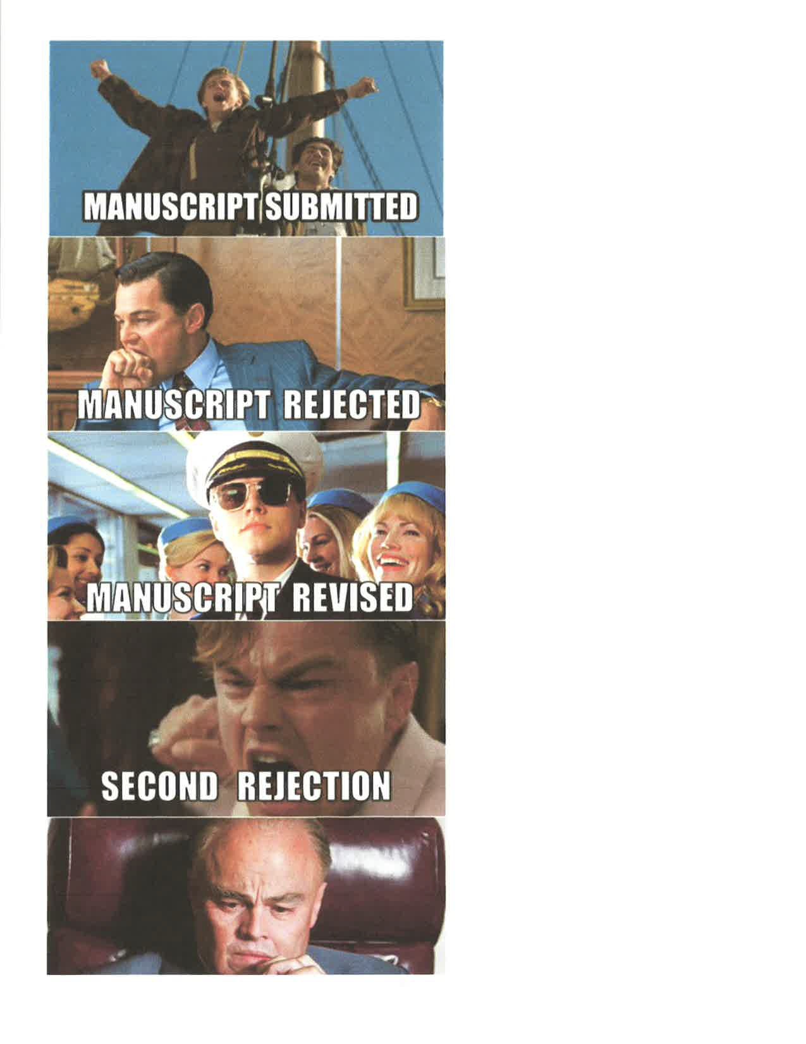
Navigating the Manuscript Submission and Editorial Evaluation Processes

Slide 85
Navigating the Manuscript Submission Process
Manuscript systems vary from journal to journal
  Differ in degrees of difficulty with submission process
Differ in information requirements
  Author information – location/affiliation, authorship forms, COI disclosures, funding statements
  Detailed contact information for corresponding author with backup contact person if needed
Differ in submission requirements
  For manuscript – abstract format, text length, etc
  Combined vs separate files for tables/figures
  Requirements for supplemental materials

Slide 86
Manuscript Submission - Cover Letter
Provide brief, detailed cover letter (1 page)
  Address to Editor – Personalize
  NOT - “Dear Editor” “Dear Sir” or “Dear Madam”
  Definitely NOT - “Dear Sir or Madman”
  Request consideration
  Briefly summarize manuscript / key findings
  Explain why manuscript may be suitable, possible journal section
  Highlight any unusual issues
  Possibly suggest peer reviewers (requested by / required by some journals)

Slide 87
Manuscript Submission
Provide copies of closely related materials
  Confidential copies of other related manuscripts
  Copies of other closely related published articles
  Helps to avoid concerns about “duplicate publication” “salami slicing” publication, “hidden multiple publication”
  Indicate if manuscript posted pre-print server
Can only submit the manuscript to one biomedical journal at a time - Otherwise - “duplicate submission”
Once submitted, in ‘implied contract’ with journal
  In return for evaluation of manuscript by journal, authors should not disseminate any information without permission

Slide 88
Manuscript Submission
Be certain to submit correct, final, version of manuscript
Keep copies of everything
Following successful submission, should receive acknowledgment of receipt by journal
Should receive notice of assignment to individual editor
Follow-up if no reply from journal

Slide 89
Manuscript Submitted – What next ?
Try to be patient; track progress if journal web site has that capability
When to contact if no communication ?
  Depends on journal – highly variable
  1st level decision (no external review) usually 1-2 weeks
  2nd level decision (external review) usually 1-2 months

Slide 90
Manuscript Turnaround Times: Sample Data
JAMA – submission to first decision –
3 days (no review); 32 days (with review)
Accept to publication – 29 days
Submission to online publication – 57 days
Annals EM – submission to first decision -12 days
Acceptance to online publication - ~ 1 month
Academic EM - Submission to first decision –2 days
Submission to acceptance - 64 days
Acceptance to online publication - 24 days
AJPH - submission to first decision – ‘few days to 2 weeks’ (no review); ~ 1 month (with review);
Submission to acceptance ~ 2 months

Slide 91
Requesting Expedited Review / Publication
Most appropriate for major, potentially practice changing studies and reports with major public health importance and implications.
The Lancet - "fast-track publication"
  Rapid peer review (within days)
  Rapid publication – aim - within 4 weeks of submission
  Important research reports, typically major RCTs
JAMA - JAMA Express - expedited review / processing
  Goal - online publication within 4 weeks of submission.
  Reserved for manuscripts that will be presented as late-breaking research at major scientific meetings or those with time-sensitive findings of major clinical or public health importance.

Slide 92
Requesting Expedited Review / Publication
JMIR – usual decision time – “we aim for an average decision time of 2 months after submission for papers sent for peer-review.”
Has Option for “Fast Track” - Expedited editorial processing and publication: Initial editorial decision - within 20 business days after submission and
Expedited production to publication within 4 weeks after acceptance
Requires “non-refundable fast-track fee (FTF)” - $950

Slide 93
Most Common
Initial Editorial Decisions
Reject - without review
Reject - with review
Reject and submit a new manuscript
Revise and resubmit the manuscript
Accept if suitably revised

Slide 94
Rejection Decisions
May evoke disappointment
Try not to take decision as personal reflection
Understand reasons for rejection
  Perfectly acceptable to ask
  e.g., not good fit, timing, competing manuscripts,
  Avoid challenging decision if editor provides reason
Wait a couple days (no more)/plan for next journal
** Carefully consider any comments received, revise manuscript accordingly,** prepare and reformat manuscript to submit to next journal

Slide 95
Do journals make mistakes with rejection decisions ?
1937 -Nature rejected Hans Kreb’s manuscript on ‘citric acid cycle’; Krebs- 1953 Nobel Prize: discovery of ‘citric acid cycle’
1955 - Journal of Clinical Investigation rejected Rosalyn Yalow’s manuscript on invention of radioimmunoassay
  Yalow – 1977 Nobel Prize for RIA
1993 – Science rejected Kary Mullis’s manuscript on the first report of polymerase chain reaction (PCR)
  Mullis – 1993 Nobel Prize for PCR
2015 – JAMA and NEJM rejected Angus Deaton’s manuscript on mortality in “midlife white Americans”
  Deaton – 2015 Nobel Prize in Economics – “for analysis of consumption, poverty, and welfare."

Slide 96
Should Authors Appeal Rejection Decisions ?
** Overall, usually a low yield strategy**
For an appeal, provide objective, well-supported, evidence-based argument and rationale for the request
Most effective if can present convincing argument with evidence (eg, apparent editorial or reviewer error or reviewer misunderstanding of new development)
Better if can present new methods, new analysis, and new data
NOTE – simply responding to reviewers’ comments and requesting reconsideration of a revision - not sufficient
  Reviewers are consultants
  Reviewers may have made other comments / recommendations to editors

Slide 97
Appealing Rejection Decisions
Write a Letter
“We are writing to respectfully request that you please reconsider the editorial decision for our manuscript, entitled ‘[title]’. We are grateful to the editors and reviewers for their thorough evaluation of our manuscript, and for their thoughtful suggestions and comments. It appears there are several main areas of concern, and we would appreciate your consideration of our responses to these concerns, as well as some additional information that may be relevant for your evaluation of this request.”
Discuss key issues objectively, professionally, and in an emotion-less and non-argumentative fashion.
Politely request whether editors would be willing to entertain the request for reconsideration

Slide 98
Appealing Rejection Decisions
The Lancet
“Sometimes editors make mistakes. When we do, we like to hear about them. If an author believes that an editor has made an error in declining a paper, we welcome an appeal. In your appeal letter, please state why you think the decision is mistaken, and set out your specific responses to any peer reviewers’ comments if those seem to have been the main cause of rejection.”

Slide 99
Appealing Rejection Decisions - Annals of EM
If you wish to appeal a decision, you can submit a formal appeal outlining your concerns and providing detailed reasoning as to why you believe the original decision was incorrect
Clearly state the reasons for your appeal, citing specific points from the reviewers' comments or concerns you disagree with, and provide evidence to support your arguments.
Maintain a respectful and professional tone throughout your appeal.
If you have any new data or evidence that was not included in the original submission that could strengthen your case, include it in your appeal.

Slide 100
Appealing Rejection Decisions
Example - Annals of Surgery
If authors disagree with decision, may submit appeals letter
In rebuttal, must address concerns raised in decision letter, and provide reasoning for why manuscript should be reconsidered
Appeal must be received within 30 days of decision letter
No other manuscript materials should be sent unless invited by editor to do so
“The decision of the Editor-in-Chief is final.”

Slide 101
Rejection of Rejection Letter
SPOOF of letter from author to journal
BMJ:2015:351:h6326
“Thank you for your rejection of the above manuscript. Unfortunately, we are unable to accept it at this time. As you are probably aware, we receive many rejections each year and are simply not able to accept them all. In fact, …we typically accept fewer than 30% of the rejections we receive. Please don’t take this as a reflection of your work. The standard of some of the rejections we receive is very high.”
“Please understand that our decision regarding your rejection is final. We have uploaded the final manuscript…and look forward to receiving the proofs and working with you in the future”
.

Slide 102
Invitation to Submit a Revised Manuscript After Peer Review and Editorial Evaluation
Type of letter authors hope to receive
For many journals, only sent for relatively small proportion of submitted manuscripts
** Respond promptly **
  Most journals will give suggested timeline
    (Typically - 2-3 weeks)
  Lancet – “Authors should give priority to invitations to submit revisions; the journal will reciprocate by making a final decision quickly.”

Slide 103
Submitting a Revised Manuscript
Ensure that manuscript is revised thoroughly, completely, and is responsive to all issues raised by editors and reviewers
**Prepare an effective response letter**
  Powerful tool for authors
  Thorough, complete, detailed
  Professional and polite tone
  Poorly prepared, unsatisfactory response letter often indicative of an incomplete, unsatisfactorily revised manuscript

Slide 104
Author Response - Cover Letter
Address letter to the editor who invited the revision
Express appreciation for the review
Indicate authors are diligent/ serious with the revision
Highlight specific major issues (if present) and provide documentation to address those issues
Indicate how the comments were addressed
Comment on the status of the manuscript
  Eg, report if manuscript posted on a preprint server
Mention all authors reviewed/agree with the revised manuscript and note if any authors have relevant COI

Slide 105
Preparing Responses to Comments
Three parts in the response to each comment:
1) Cut and paste each reviewer / editor comment
  Verbatim, not paraphrased or summarized
2) Provide detailed, direct response to the comment with rationale and references, as needed
3) Indicate exactly how manuscript was revised.
  Include new text (cut / paste from manuscript)
  Indicate location in revised manuscript
  Include new tables and figures (if created)

Slide 106
Example of response to a reviewer comment
Reviewer 1, Comment 1: “Title - The title of the manuscript “Effect of sex on honorary and ghost authorship” should be revised to reflect the study design and objective more appropriately. The study design does not support causal inference regarding the effect of author sex on inappropriate authorship, and the authors do not present data on association between sex of the corresponding author and honorary or ghost authorship, but rather only present prevalence data.”
Author response: We agree with the reviewer regarding the need to revise the title, the inability of the study design to establish causal inference, and the lack of data on the relationship between sex of the corresponding author and honorary or ghost authorship. We have refocused the manuscript to assess prevalence of inappropriate authorship.
Manuscript revision: Title, Line 1 – the title has been revised as: “Prevalence of honorary and ghost authorship in 6 biomedical journals in 2022.”

Slide 107
Response Letter
* Overarching goal – “one and [nearly] done”
Goal – next letter from the journal = acceptance
Comprehensive, complete document
More [detail and information] is definitely better
Makes editorial re-evaluation of the revision easier
  Everything in one place (the response letter)
Ensure that locations designated in response letter accurately reflect location in the revised manuscript
* Leave no open issues
Contact editor if there are major questions about or discrepancies in comments from editors and reviewers

Slide 108
Response Letter
Not required to make every change
Clearly state position / rationale for any disagreement (with supporting evidence)
  Not based simply on author preference, beliefs, etc
AVOID invoking manuscript word length / table limits as a reason not to address a comment or make a recommended substantive change
  Could add information / tables to supplement, if needed
AVOID responses like “done” (except for the most simple, straightforward comments
Express willingness to negotiate

Slide 109
Submitting the Revised Manuscript
Ensure that locations designated in response letter accurately reflect location in the revised manuscript
Clearly indicate - manuscript represents a revision
Adopt all editorial recommendations for style and presentation, unless meaning is changed
Ensure that corrected / updated tables, figures, references, supplemental materials are included
If track changes version required, ensure version is identical to ‘clean’ version with changes accepted
Ensure that all authors have reviewed / agree with revised version of manuscript (and responses)

Slide 110
Caveats about revised manuscripts
Submission of revised manuscript does not guarantee acceptance
With revision, issues may arise that amplify flaws, reveal new problems, or raise additional concerns
Additional peer review may be required
Additional revision may be required
Other manuscripts on similar/closely related topic may receive higher priority for publication
Even if revision is rejected, result is usually an improved manuscript (“free expert consultation”)

Slide 111
Provisional Acceptance
Assuming satisfactory revision
  Acceptance letter with remaining items to address
Resolve all issues / queries promptly
  eg, may require additional minor revision
  eg, may require revised / new graphics
Provide any missing items
  author forms, disclosure information, etc
Some journals will not issue final acceptance / schedule for publication until all details resolved

Slide 112
Post-Acceptance
Be available – may request tentative timeline (publication date) from journal
Prompt review of page proofs
Cooperative, collaborative approach
***No new data; no major rewriting
***No changes in authorship

Slide 113
Prepublication Release of Information
For manuscripts under review or accepted, these are general guidelines:
* No release of information from manuscript until journal indicates (ie, journal embargo lifted) or grants permission
  Common exception – presentation at scientific meeting
* No submission or publication of full manuscript or substantial portions elsewhere, without permission
  Evolving policies with pre-print servers
    Some journals allow posting accepted manuscript (eg, institution website) at time of publication
* No news conferences or news releases “Publication by press conference” (unless journal grants permission)

Slide 114
Interacting with Journals
Avoid inciting ‘pet peeves’ of editors
Incite pet peeves – most likely not automatic rejection
Avoid pet peeves –may be helpful in favorable interactions
Some selected examples of editorial pet peeves:
Authors’ apparent lack of familiarity with journal
Failure to follow information for authors
Expectation - preferential treatment / exceptions to policies
Request expedited review and publication for manuscript that had been reviewed/ rejected by another journal
Unresponsive revisions and unsatisfactory revision letters
Misrepresentation/incomplete reporting (facts, data, COI)
Argumentative, confrontational tone / interactions

Slide 115
Interacting with Journals
Should be a mutually respectful, mutually beneficial process
Enables development of author-editor relationships
May serve as basis for future interactions
Ultimately, authors and editors have same goal = publication of high-quality work

Slide 118
Strategies for Scientific Writing
Expect multiple drafts
Once first draft is completed – try to put manuscript aside for a few days
Focus on other tasks (eg, tables, figures)
Double check data / calculations
Take a fresh look at the manuscript and begin revision to prepare second draft
Put on your “editor” hat
Ask trusted person/colleague to review

Slide 119
Results – General Concepts
Should follow framework established in methods
Consider framework for results in reporting guidelines
  eg, Consort, Strobe, Prisma, etc
Data pertinent to research question
Include results whether statistically significant or not
Quantitative values in text (especially for primary outcomes, acceptable to have some redundancy with data in tables and figures)
  Individual values, group values
  Comparisons between groups
Cite tables and figures that present data

Slide 120
Selected Sample Titles
February 2025
AJPH
Legacy of Racism and Firearm Violence During the COVID-19 Pandemic in the United States
US State Recreational and Medical Cannabis Delivery Laws, 2024
Annals EM
Tranexamic Acid in Pediatric Traumatic Brain Injury: A Multicenter Retrospective Observational Study
Door-In-Door-Out Times at Referring Hospitals and Outcomes of Hemorrhagic Stroke

Slide 121
Selected Sample Titles
February 2025
Academic EM
“He was not listening to hear me”: Parent experiences with communication, inclusion, and marginalization in the pediatric emergency department
Enhancing geriatric trauma mortality prediction: Modifying and assessing the Geriatric Trauma Outcome Score with net benefit and decision curve analysis

