Slide 1
Developing and Using an Individual Development Plan
Kristen K. Mighty, PhD, MPH
Senior Program Coordinator, Office of Postdoctoral Affairs
Postdoctoral Skills Workshop
February 10, 2016

Slide 2
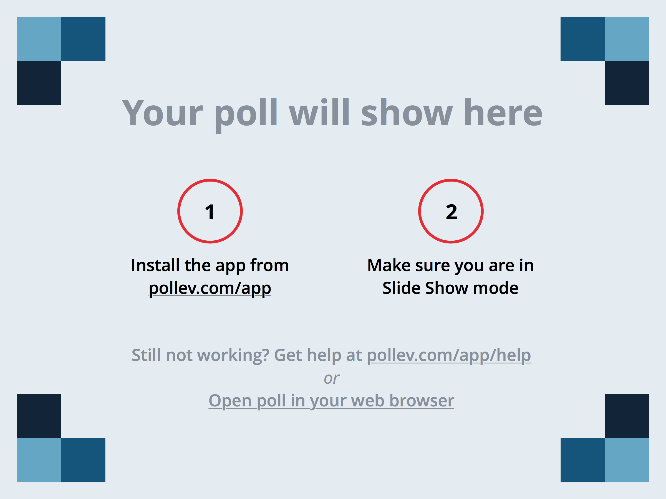
Notes:
What feelings do you have when thinking about career planning? https://www.polleverywhere.com/free_text_polls/bO0Fw4vPfESpy1C

Slide 3
What is an Individual Development Plan?
Structured Planning Tool
Set immediate and short-term goals, improve productivity
Set long-term goals that fit individual skills, interests, values
Facilitate structured discussions with mentor(s)/advisor(s)
Not a finite process, revisit every 6-12 months

Slide 4
Notes:
Do you have an Individual Development Plan (IDP)/ Career Development Plan (CDP)? https://www.polleverywhere.com/multiple_choice_polls/t6WvYQoX23cwNvp

Slide 5
Getting Started
1
2
3
Assess
Skills
Interests
Values
Explore
Review Assessments
Review Career Path
Identify areas of skill building
Create & Implement Plan
Career Advancement Goals
Skill Goals
Project Goals
Mentoring Team
myidp.sciencecareers.org/

Slide 6
Assessments
Skills
A subjective self-assessment of your skills
Identify the skills/knowledge areas, proficiencies/weaknesses that could use some attention
Based on the National Postdoctoral Association's (NPA) core competencies for PhD scholars
Interests
Subjective assessment of professional interests
Define tasks that are enjoyable and would like to include as integral career elements
Values
Subjective assessment of your values (principles by which you live)
Help answer the questions: "What is most important to me? What rewards or outcomes do I want from my work?”

Slide 7
Scientific Skills Assessment
Rate yourself on:
Scientific Knowledge
Research Skills
Communication
Professionalism
Management & Leadership Skills
Responsible Conduct of Research
Career Planning
Resources:
NPA Postdoctoral Core Competencies Toolkit
Article: So You Think You Have Skills
Notes:
The next several slides give an idea of what the online assessment looks like for the skills, interests and values assessments

Slide 8
Interests Assessment
Intended to help you define:
Tasks you enjoy doing
Tasks that you would like to avoid
Focus on component tasks
Refer to AAAS article on Interests to guide you in thinking about this assessment
“A careful and detailed analysis of ‘interests’ is at the core of the assessment phase at myIDP”

Slide 9
Values Assessment
What is most important to me?
What rewards or outcomes do I want from my work?”
Goal is to define the environment in which you are likely to function best, and the conditions of a job that will keep you motivated.
Read article “What do you care about” that may help when thinking about this section
Notes:
The next several slides give an idea of what the online assessment looks like for the skills, interests and values assessments What I’d like for us to take a moment and do right now is review pages 9-15 in the handout to brainstorm on some ideas involved in the self assessment. This will facilitate completing online assessment using the tool later.

Slide 10
Getting Started
1
2
3
Assess
Skills
Interests
Values
Explore
Review Assessments
Review Career Path
Identify areas of skill building
Create & Implement Plan
Career Advancement Goals
Skill Goals
Project Goals
Mentoring Team
myidp.sciencecareers.org/
Notes:
----- Meeting Notes (2/9/16 12:42) -----
Done online, the assessment doesn't take much time, build into schedule, be thoughtful and use range of scores. That's the first step...
Next...

Slide 11
Career Exploration
Your skills and interests match percentage is ranked for each path and listed highest to lowest
This is not like a personality/leadership style test
Many ways to use this information
See career paths that align at this point in time
Identify what skills need improvement (set goals)
Learn what skills needed for career paths

Slide 12
Career Resources

Slide 13
Other Resources
Higher Education Recruitment Consortium (HERC)
Greater Chicago Midwest (GCM-HERC)
Dual-career couples
Professional development webinars/articles
Versatile PhD
Northwestern Career Advancement (accessible with netid/password)
Wetfeet
Hoovers
Career Insider (Vault)
Office of Postdoctoral Affairs
Online resources: http://www.tgs.northwestern.edu/resources-for/postdocs/career-resources/index.html
Individual appointments
Campus Events (info sessions, panel discussions, L&OD classes, etc...)
Informational Interviews (LinkedIn, Professional Organizations)
Notes:
This will be one area where you spend a lot of time

Slide 14
Work with a partner
1. Skills Assessment
2. Career Aspirations
Introduce yourselves:
Name, Years at Northwestern, and Dept/Center/Institute
Using the handout provided:
Think of 2-3 skills you currently have
Think of career path of interest now
What do you like about it?
What do you value about work environment?
Desired skills
Professional Development
What support can I take advantage of?
3. Desired Skills
4. Professional Development
Notes:
----- Meeting Notes (2/9/16 12:42) -----
thinking about what i've presented about the skills assessment and career exploration, let's pause and think about where we think we stand right now.
Work with a partner... Four boxes 1 to 4
Just want you to get familiar with the how you can use this handout

Slide 15
Notes:
Which box was most difficult to fill in? https://www.polleverywhere.com/multiple_choice_polls/2tCnpggiB31eAsm
----- Meeting Notes (2/9/16 12:42) -----
thanks for answering the poll.
address what was most difficult and possible strategies to improve

Slide 16
Getting Started
1
2
3
Assess
Skills
Interests
Values
Explore
Review Assessments
Review Career Path
Identify areas of skill building
Create & Implement Plan
Career Advancement Goals
Skill Goals
Project Goals
Mentoring Team
myidp.sciencecareers.org/
Notes:
This is where your plan starts to become reality
----- Meeting Notes (2/9/16 12:44) -----
let's pull it all together

Slide 17
SMART/SMAHT Goals
Specific
Action-oriented
Is there an action required on your part?
Is it focused and unambiguous
Realistic/Help
Time-bound
R: Considering difficulty and timeframe, is this goal attainable?
Could someone identify whether or not you achieved this goal?
By when should you complete this goal?
H: Does it identify what support you need and where you’ll get it?
Measurable

Slide 18
SMAHT goal example:
Read articles/books about medical device industry
Read 1-2 new articles per week
Take Erin out to coffee each Wednesday and tell her about what I learned
Seek input from Erin and career advisors
Recurring weekly from Oct. 1st to Nov. 1st
S
= Specific
= Measurable
= Attainable
= Help
= Time-bound
M
A
H
T

Slide 19
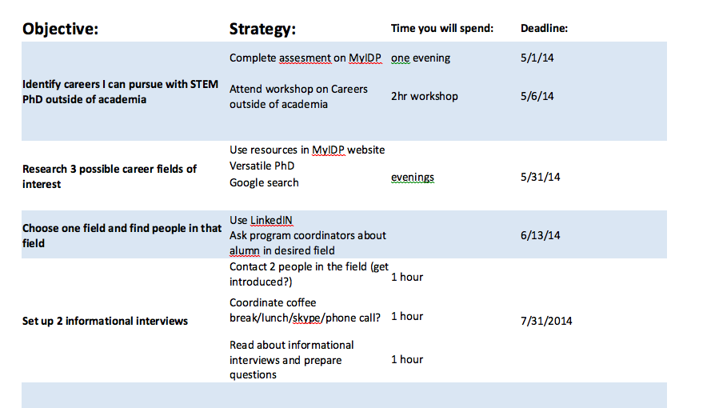
Example SMAHT goals:
Zulmarie Perez – Cellular and Molecular Pathology
University of Wisconsin-Madison, CIRTL online IDP workshop

Slide 20
Next Steps: Setting Goals
Use the assessments to determine what career path aligns best with your skills, interests and values (Keep in mind that there is no such thing as a perfect career fit)
1
2
3
Set Goals
Career Advancement
Skills
Projects
Timeframe
Immediate (6-12 months)
Short-term (1-3 years)
Long-term (3-5 years)
Keep in Mind
Revisit IDP regularly & often
Desires may change as knowledge increases
Availability of opportunities & resources may also change

Slide 21
Work with a partner
S
= Specific
= Measurable
= Attainable
= Help
= Time-bound
Using the handout provided:
Identify a skill you would like to improve (writing, editing, broad knowledge of field, etc…)
Draft a goal(s) to improve skill
Career advancement/Skills/Project
Refer to 1st partner exercise handout
Don’t forget to give yourself a deadline
M
A
H
T

Slide 22
Getting Started
1
2
3
Assess
Skills
Interests
Values
Explore
Review Assessments
Review Career Path
Identify areas of skill building
Create & Implement Plan
Career Advancement Goals
Skill Goals
Project Goals
Mentoring Team
myidp.sciencecareers.org/

Slide 23
Notes:
With whom do you talk about career goals? https://www.polleverywhere.com/multiple_choice_polls/K3WC8ABiEsRwVyv

Slide 24
Let’s Talk Mentors
Not limited to your direct supervisor/advisor
Often beneficial to have different/mulitple mentors for project and career development (mentoring teams)
Prepare for discussions with your mentor (refer to handout page 2)

Slide 25
Notes:
What are barriers to successful mentor-trainee conversations? https://www.polleverywhere.com/free_text_polls/6MdE9W8Tm0SnwJc

Slide 26
Work with a partner
Using the handout provided
Discuss what strategies can you use to work around these barriers?

Slide 27
Notes:
What strategies did you come up with? https://www.polleverywhere.com/free_text_polls/T2eVDgdXl3pgCZQ

Slide 28
Take a moment…
Using the handout provided, jot down:
Who else do you need to follow-up with?
What should next steps be after this workshop?
How can you plan to follow-up with your mentor?

Slide 29
Resources
Higher Education Recruitment Consortium (HERC)
Greater Chicago Midwest (GCM-HERC)
Dual-career couples
Professional development webinars/articles
Versatile PhD
Northwestern Career Advancement (accessible with netid/password)
Wetfeet
Hoovers
Career Insider (Vault)
Office of Postdoctoral Affairs
Online resources: http://www.tgs.northwestern.edu/resources-for/postdocs/career-resources/index.html
Individual appointments (both campuses)
Campus Events (info sessions, panel discussions, L&OD classes, etc…)
Informational Interviews (LinkedIn, Professional Organizations)
Notes:
Nobody ever plans to fail, but when we fail to plan, we are left in a tough spot.
Plan to succeed!
Get started early & revisit often!
Set up structure for yourself!

Slide 30
Questions?
The Graduate School, Office of Postdoctoral Affairs
Jennifer Hobbs, PhD, Assistant Dean, jennifer-hobbs@northwestern.edu
Kristen Mighty, PhD, MPH, Sr Prog Coord, k-mighty@northwestern.edu
Newsletters: OPA Wire/Funding Connection
Website: http://www.tgs.northwestern.edu/resources-for/postdocs/index.html

