Slide 1

So, You Want To Go Into Pediatrics?
Jennifer Trainor, MD
Career Advising in Pediatrics
January 19, 2017

Slide 2

What’s the attraction?
Kids:
are cuter than adults
get better faster than adults
don’t whine as much as adults
usually don’t cause their own illness
Don’t you
want to take
care of me?

Slide 3
Common Myths
All pediatricians do is see kids with runny noses & vomiting/diarrhea
If you are AOA with great board scores, you shouldn’t “waste” your hard work by going into an easy-to-match specialty
All pediatricians have low salaries
A career in pediatrics won’t offer enough intellectual stimulation
Only women go into pediatrics

Slide 4
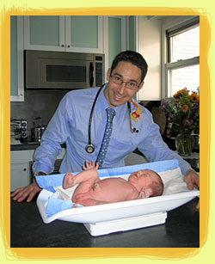
Pediatricians can:
Be primary care providers
Have longitudinal relationships with children and families
Resuscitate newborns in the delivery room & counsel adolescents on substance abuse & sexually transmitted illness both in the same day

Slide 5
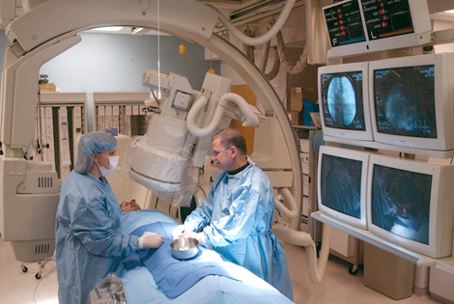
Pediatricians can:
Be subspecialty care providers
Perform procedures multiple days per week
OR never perform procedures

Slide 6
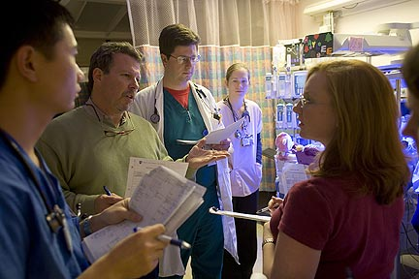
Pediatricians can:
Work exclusively in hospital-based practice
  In an academic environment
  In a community environment
Work exclusively in an outpatient-based practice
  As clinicians
  As clinician-educators
  As clinician-educator, researcher
Combine the two

Slide 7
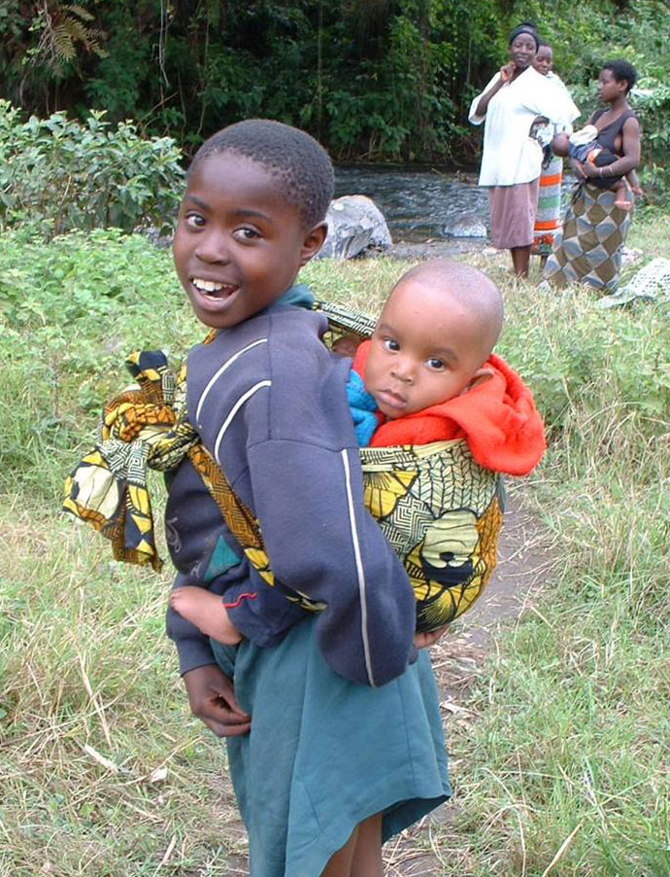
Pediatricians can:
Focus on health policy & public health
Focus on advocacy
Participate in international health opportunities
Focus on research—basic science, translational, clinical

Slide 8
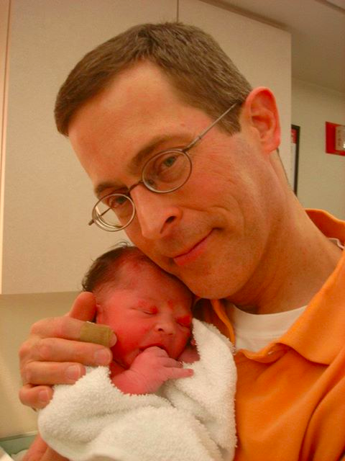
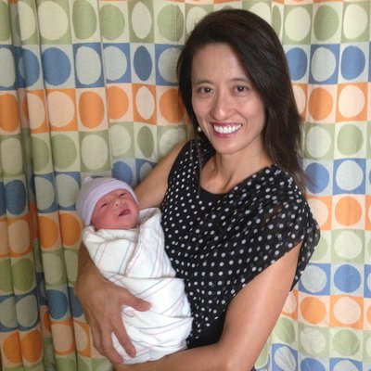
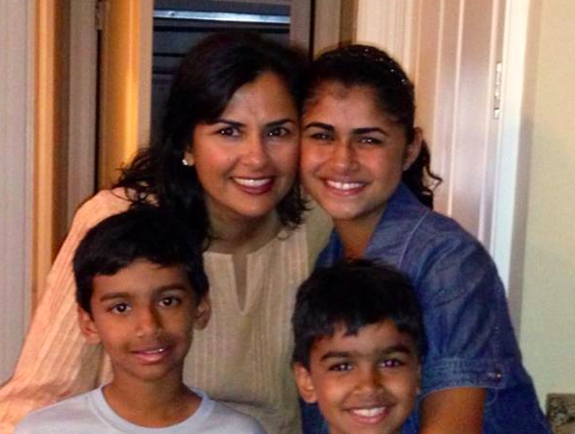
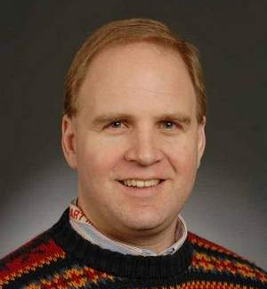

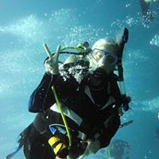
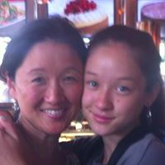
My Residency Classmates
Notes:
To give you a taste for the directions your careers can go:
Jenny G—In pediatric private practice in Northern California, worked for a time at Naval base in Japan
Bill G—did Cardiology fellowship, then Cardiology attending at academic children’s center with focus on Echo (using engineering background)
Tom R—first job after residency was for the Indian Health Service in Browning, MT (loan repayment post), worked in a academic center-affiliated general pediatric practice in Chicago, then returned to Montana and now works in a private practice in Boseman, MT
Mona K—did general peds salaried after finishing, then went back to do pediatric emergency medicine fellowship, has worked in multiple academic and private practice PEM jobs as husband’s career has evolved (with multiple city moves), has worked part and full time
Elizabeth L.—Initially did Heme/Onc Fellowship with research time at NIH. Decided to do full time research in private industry.
Arleen S.—practiced salaried gen peds in city environment as husband finished his training, then moved to Greece, sat for boards there and is in private practice there, has worked part and full time during career
Jay L—also went to Browning, MT as part of Indian Health Service loan repayment, worked in ED in Texas for a time, returned to MT to work in gen peds private practie

Slide 9
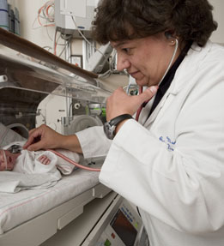
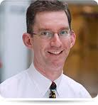
Classmates w/ Traditional Subspecialty Academic Jobs
Dr. Martin studies the impact of nutrition on the development of innate immunity in premature infants and its effect on acute short-term morbidities and long-term outcomes.
Beth Israel Deaconess Medical Center
Jordan Symons, MD, is an Associate Professor of Pediatrics at the University of Washington and Director of the Acute Dialysis Program at Seattle Children’s, where he treats general nephrology, kidney transplant and dialysis patients.

Slide 10
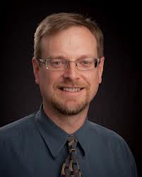
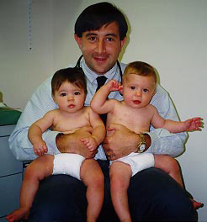
Others in Gen Peds practice
Dr. R sees pediatric and adolescent patients at the Lawndale Christian Health Center and is on staff at Mt. Sinai Hospital and St. Anthony’s Hospital for any children who need to be admitted to the hospital.
Notes:
.Dr. R's interests and involvements at Lawndale include: improving clinical quality, developing the clinic’s Electronic Medical Record, achieving Patient Centered Medical Home certification, and integrating spiritual care into patient services. Dr. Rowell has traveled twice to Afghanistan to support LCHC staff involved with medical residency training programs for Afghan doctors.
Andy B. with large peds group, university afflitated

Slide 11
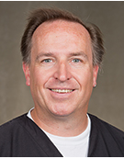
Why I am now so glad I went into Pediatrics (quite different than why I chose Pediatrics, when I knew nothing) in no certain order:
I have never disliked a kid for acting like a kid. I may have disliked a parent or the way a parent treated me, but the relationship with the kid is always awesome.
No one can ever say I am only in it for the money.
Having our own babies and children is much easier, even if it is just feeling slightly less incompetent.
Fixing a nursemaid's makes me feel heroic for doing very little.
Reassuring our over-educated friends that their normal kids are ok is great.
Pediatric residents, for the most part, perhaps because they are not chasing the most lucrative fields, are cooler and funnier to work with, followed by emergency medicine residents.

Slide 12
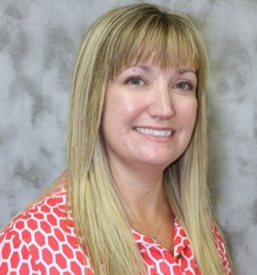
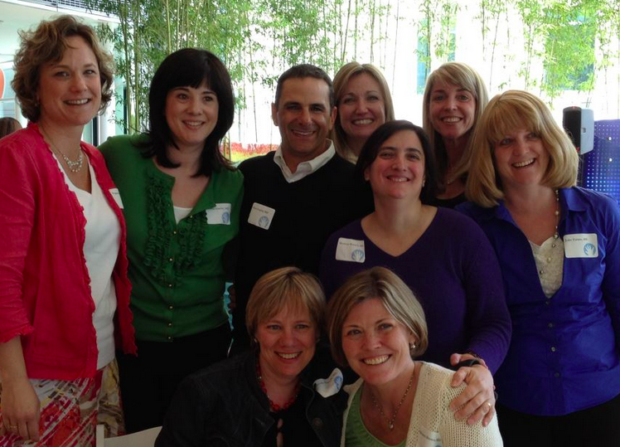
Kathy Howard
I loved the people who were already practicing it. I wanted to work with those kinds of doctors for the rest of my life. A truly compassionate selfless group of people, who managed to see the joy and humor in life despite dealing with unbelievable sadness and tragedy sometimes.
And the children always brought such joy to my days.
Plus, I've felt like a child advocate since my own tragic childhood, and whether in a small or large way was compelled to to keep children safe and do whatever I could to help them have happy, successful childhoods.
I have never regretted my decision for a second.

Slide 13
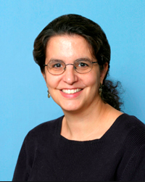
Linda DiMeglio
I chose it because I was inspired to enter medicine by my own pediatrician.
I stayed with it for many of the reasons noted previously.
I also feel strongly about advocating for those who legally need adult voices and medically need someone always acting in their best interest.
I love watching them grow and develop over the years and then being their friends and colleagues as adults.
Shorter medical histories never hurt either!

Slide 14
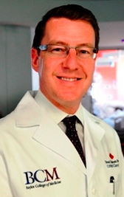
Paul Checchia
Honestly, I'm not 100% sure how I stumbled into peds. I had an overwhelming sense that pediatrics was a "noble" profession. It made far greater of an impact than internal medicine (at least in my mind).
I also knew that, in general, I didn't like adults when they were sick.
As far as my choice of critical care, I was an adrenaline junky. I remember a senior resident telling me about how you either like sick children or basically well children. If you like sick; you were heading toward PICU, ED, HemeOnc, Cards. If you like basically well children; Gen Peds, ID, Renal.
What is more interesting to me is the things that I love about my career now have nothing to do with what I originally liked. The clinical practice is fine, but the research, administration, team building, problem solving have all created fun challenges that I never would have anticipated.

Slide 15

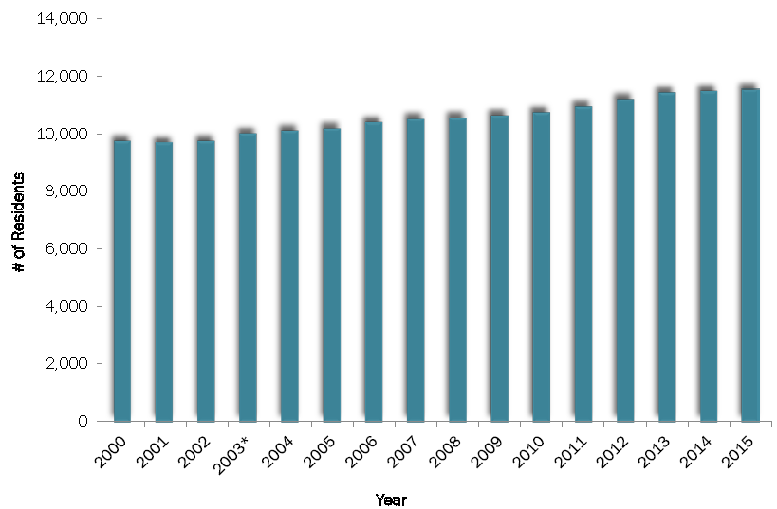
How many pediatricians do we train per year?

Slide 16
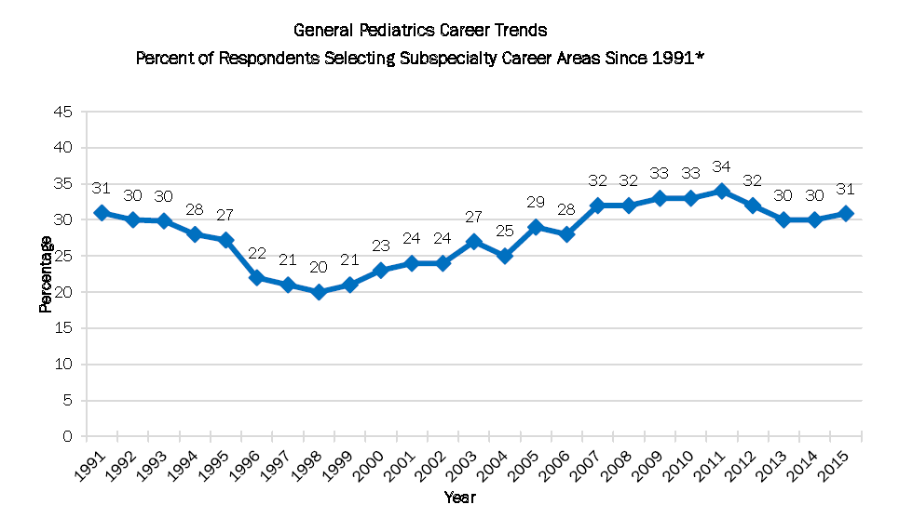
What percent of peds residents go into subspecialties?

Slide 17

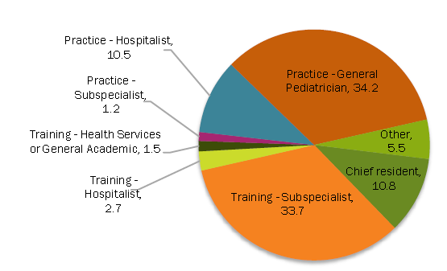
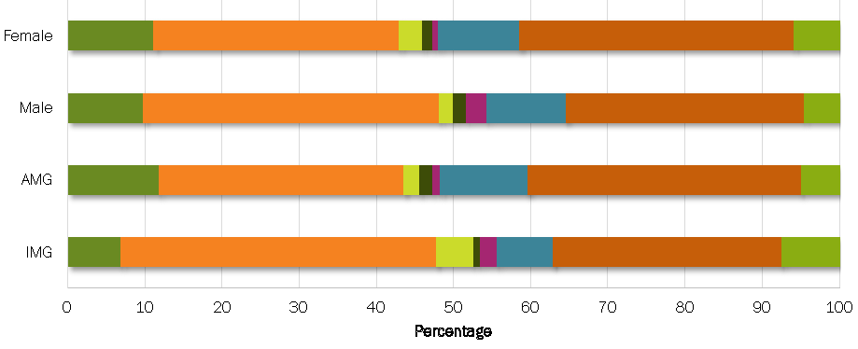
What do we know about recent residency graduates?
ABP Workforce Data 2015

Slide 18
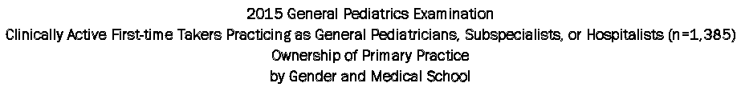
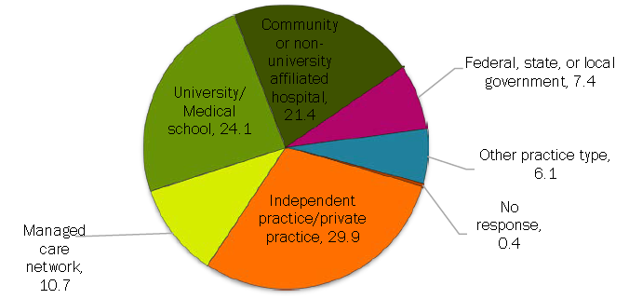
In what practice setting do new grads work?
2015

Slide 19
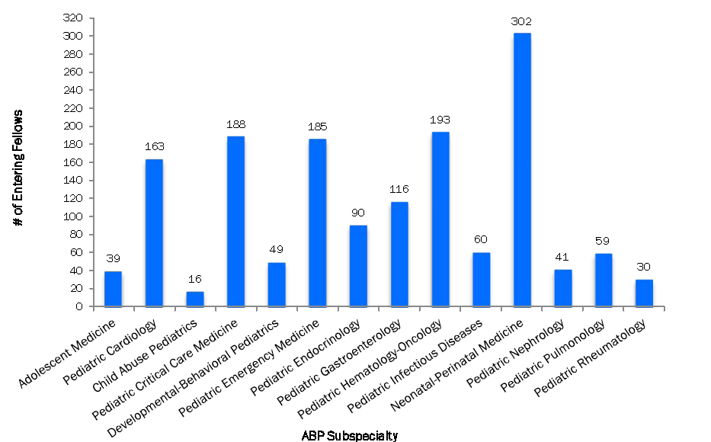

What subspecialties did pediatricians choose?
2015

Slide 20
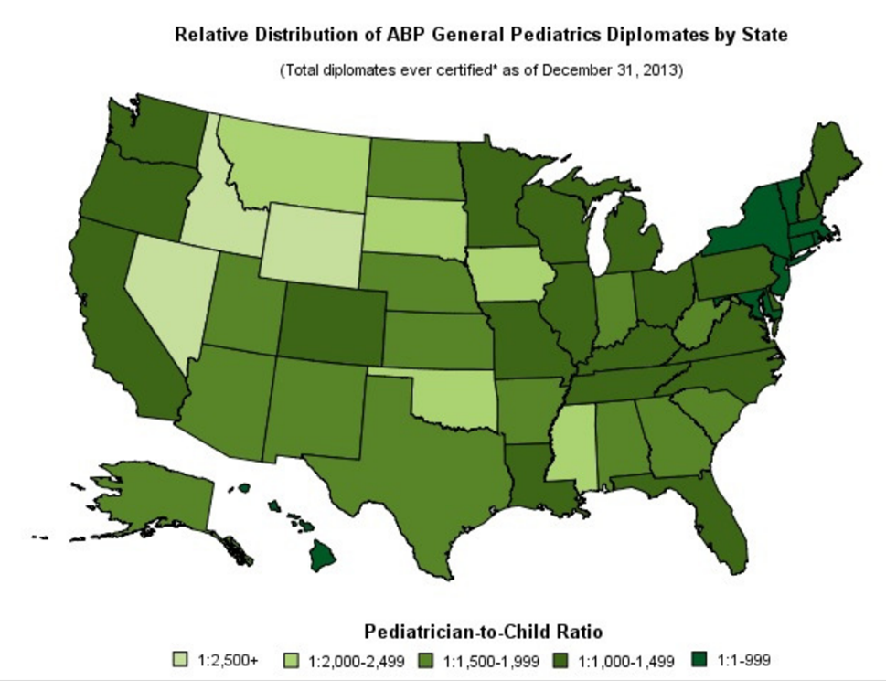
Where are the pediatricians?

Slide 21
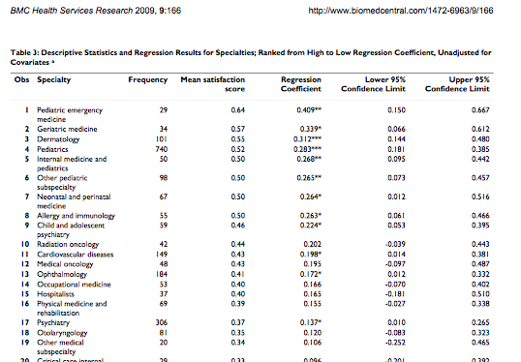
Are pediatricians happy?

Slide 22
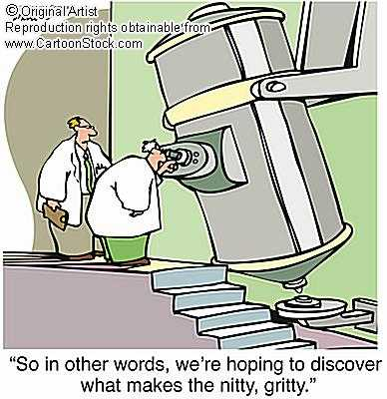
Now let’s get to what you really want to know…

Slide 23
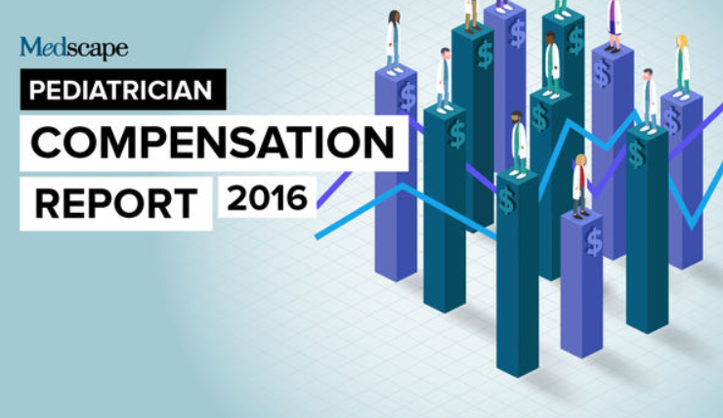
Notes:
Surveyed 22,000 physicians in practice. Couldn’t figure out how many were pediatricians. All practice types.

Slide 24

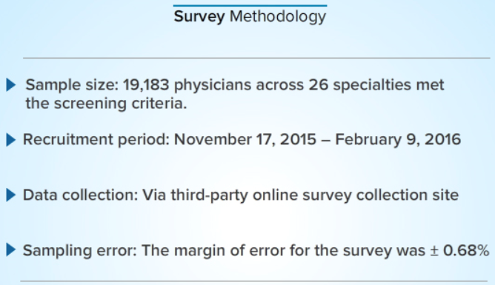
Notes:
1534 pediatricians

Slide 25
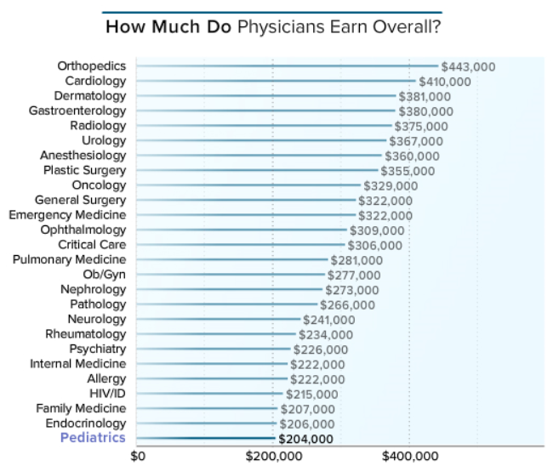
Overall Physician Compensation
2016

Slide 26
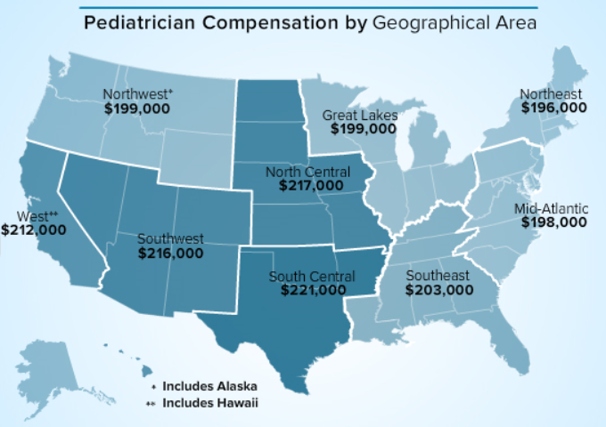
Compensation by Geographic Area

Slide 27
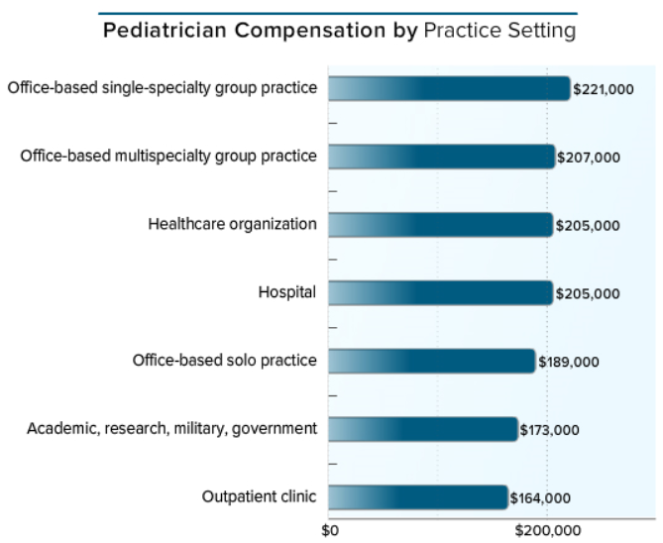
2016 Practice Setting Income

Slide 28
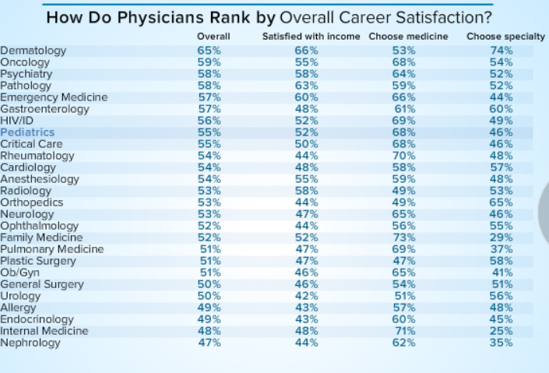
Career Satisfaction

Slide 29
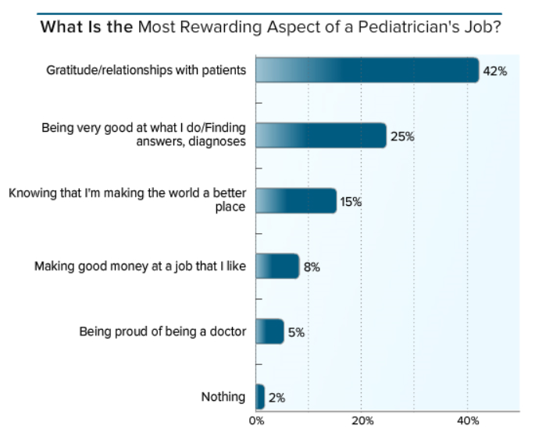
Rewards of the Job

Slide 30
Average salary by pediatric subspecialty
 | Annual Salary ($)
Endocrinology | 185,901
Gastroenterology | 236,700
Hematology/Oncology | 205,999
Intensive Care | 265,913
Nephrology | 217,767
Neurology | 209,955
Pulmonology | 176,974
Infectious Disease | 199,165
Cardiology | 244,944
2009 Physician Compensation Survey by the American Medical Group Association
Notes:
CejkaSearch.com published the following data showing median pediatrician compensation, by specialty. The original data is from the AMGA (American Medical Group Association) 2009 Physician Compensation Survey:
Specialty Median Pediatric Allergy $195,973 Pediatric Cardiology $244,944 Pediatric Endocrinology $185,901 Pediatric Gastroenterology $236,700 Pediatric Hematology / Oncology $205,999 Pediatric Infectious Disease $199,165 Pediatric Intensive Care $265,913 Pediatric Nephrology $217,767 Pediatric Neurology $209,955 Pediatric Orthopedic Surgery $424,367 Pediatric Pulmonology $176,974 Pediatric Surgery $400,591 Pediatrics & Adolescent Medicine
$202,832 Additional pediatric subspec

Slide 31
Loan Repayment Options
NIH Extramural Pediatric Research Loan Repayment Program
  http://www.lrp.nih.gov/about_the_programs/pediatric.aspx
  Pediatric investigators, up to $35,000/year
National Health Service Corps
  http://www.idph.state.il.us/about/rural_health/NHSC_State_LR_program_app.pdf
  Up to $120,000 total for 4 year commitment
  Primary care pediatrics
Indian Health Service
  https://www.ihs.gov/loanrepayment/
  Up to $20,000/yr, min 2 year commitment, plus additional 20% to offset tax liability

Slide 32
What do we know about the match in pediatrics?

Slide 33
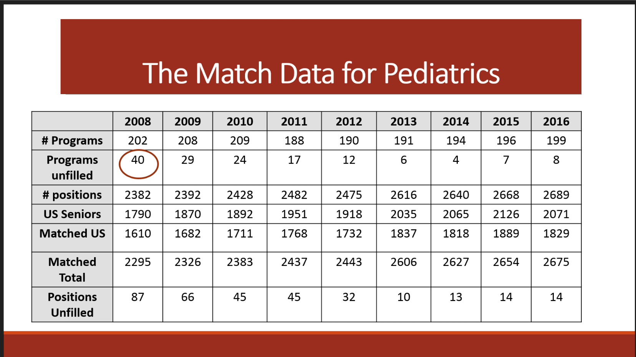

Slide 34
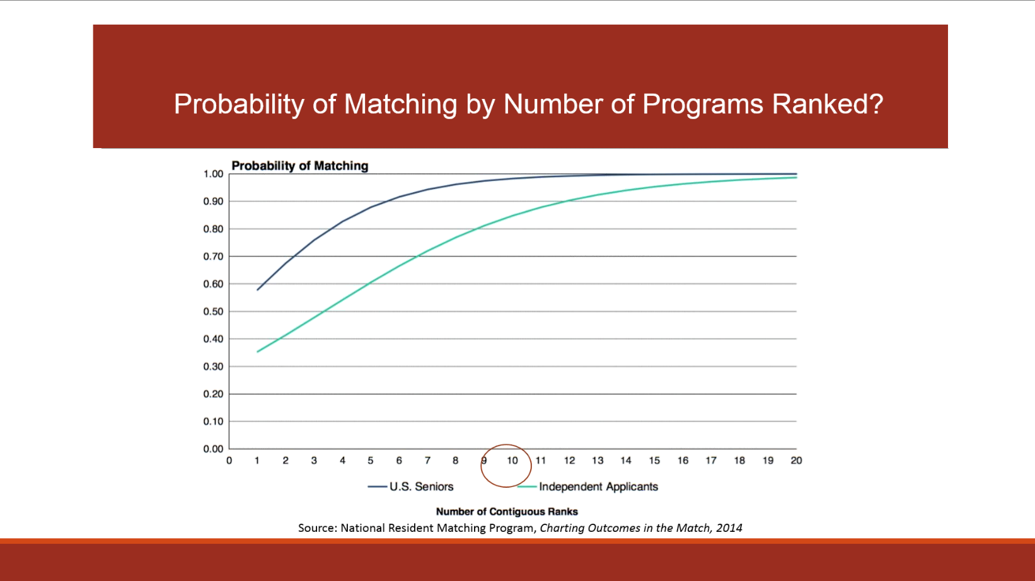
Notes:
Independent—combines US and non-US IMGs and non this year US graduates. No increase match rate after 8-10 programs. 80% of US seniors match into one of their top 3 programs

Slide 35
How Many Students Go Into Pediatrics?

Slide 36
Where do Feinberg Students Go?
Matches in Pediatrics 2005-2016
McGaw/CMH/Lurie Children’s | 29 |  | UCLA, Cornell , Pittsburg Children’s | 4
MCOW Children’s/Milwaukee | 12 |  | Harbor UCLA, Rush, Lutheran | 4
University of Chicago/Comer | 8 |  | U Vermont, USC-LAC, UC San Diego | 3
Boston Children’s (BCMC) | 7 |  | Nationwide (OH), Miami Children’s, U Arizona | 3
Children’s Los Angeles | 5 |  | Stanford, Johns Hopkins, Duke, Denver | 2
DC Children’s | 5 |  | Columbia, UNC, Loma Linda, UCSF, Monte | 2
Indiana U/Riley Children’s | 6 |  | Case Western, UCI, Christ | 2
Oakland Children’s | 6 |  | Yale, UVA, Mt. Sinai, NYU, U Conn, Children’s Mercy/KS, U Minnesota, SUNY Syracuse, Primary Children’s (Utah) | 1
Baylor/Houston | 6 |  | Cleveland Clinic, U MD, U Wisc/Mad | 1
Cincinnati, CHOP, Seattle, Wash U, Cincinnati Childrens | 4 |  | UT/Houston,U Tennessee, Wake Forest, Loyola, UVA, USD,Military, … | 1

Slide 37
Planning for next year
Sign up for an advisor if you think you may be interested in pediatrics
Note if you have a previous relationship/special interest
Set up a meeting in February to discuss plans
Bring transcript, narrative evaluations for clerkships
Make sure you sign up for pediatric subinternship
Avoid taking all pediatric electives

Slide 38
Planning for residency match
Plan at least one elective over the spring/summer to allow a pediatric faculty member to get to know you well for LOR
Work on essay and CV over the late spring/early summer
Meet with the chair for advising/chair letter
Get your application materials into ERAS as early as possible, especially if you are a weaker applicant GOAL SEPT 1. Apply SEPT 15.
When programs will grant interviews has been a moving target, some October, some November

Slide 39
Bibliography

Slide 40
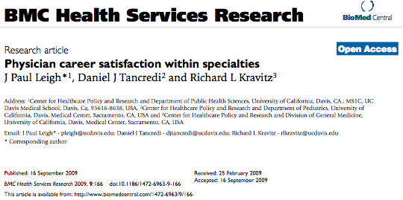
Bibliography

Slide 41
Bibliography
American Board of Pediatrics Workforce Data
Available online at https://www.abp.org/sites/abp/files/pdf/workforcebook.pdf
Match Data: http://www.nrmp.org/match-data/main-residency-match-data/
Lots of other interesting information available on this site as well: https://www.abp.org/abpwebsite/publicat/researchpub.pdf
Salary data: http://www.medscape.com/features/slideshow/compensation/2016/pediatrics

Slide 42
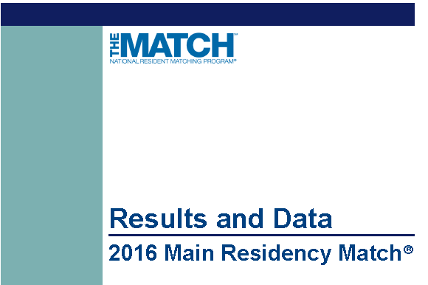
National Resident Matching Program, Results and Data: 2016 Main Residency Match®. National Resident Matching Program, Washington, DC. 2016.

Slide 43
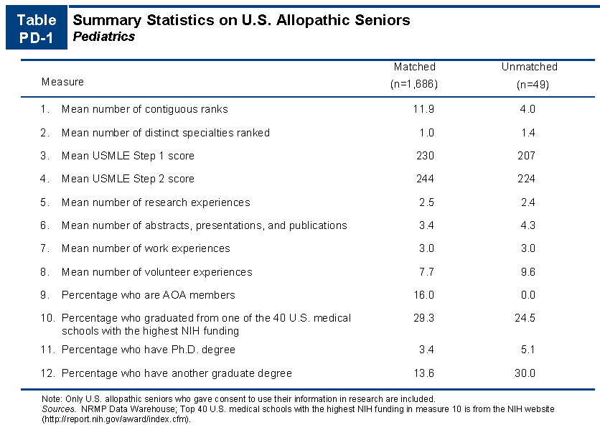
NRMP
Charting Outcomes in the Match 2016
Notes:
http://www.nrmp.org/match-data/main-residency-match-data/

Slide 44
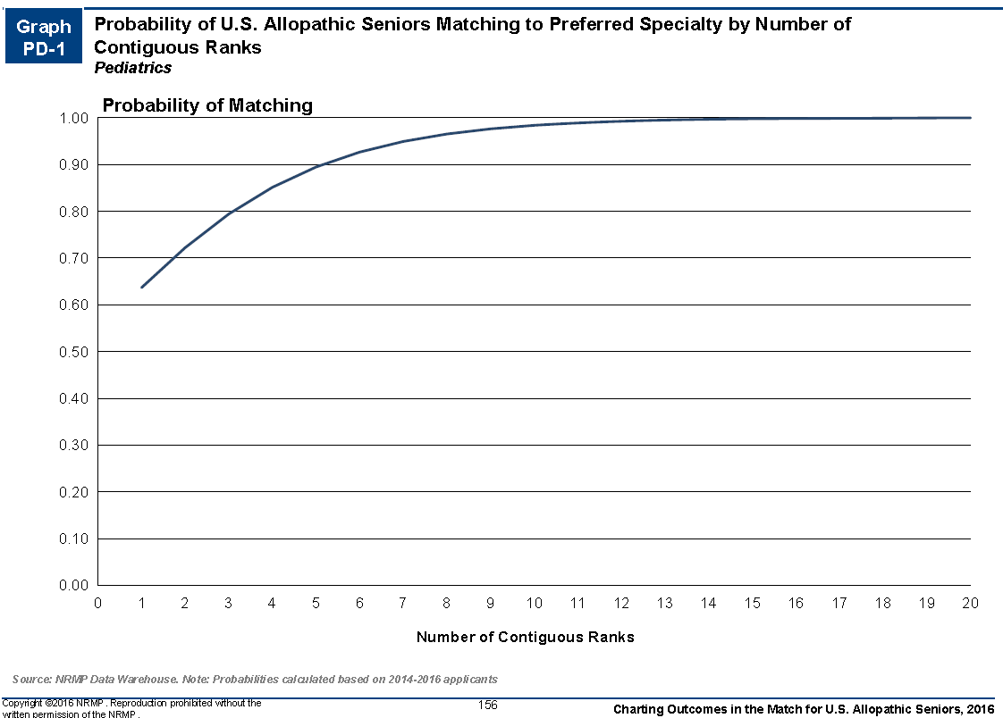
Probability of Matching by Number of Programs Ranked

Slide 45
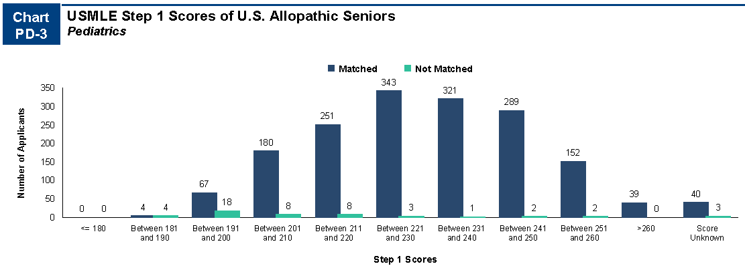
Distribution of USMLE Step 1 Scores
Charting Outcomes in the Match NRMP 2016

Slide 46
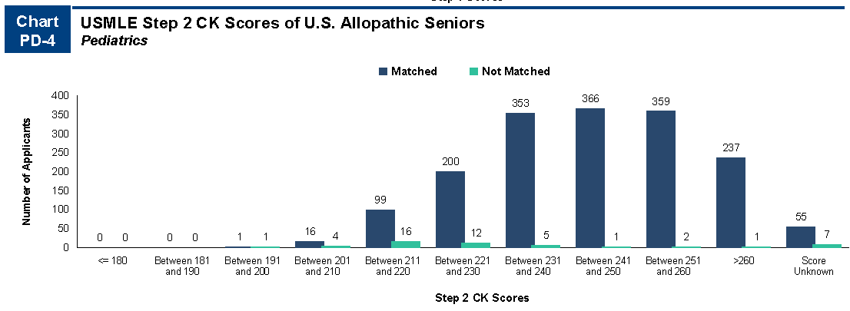
Distribution of USMLE Step 2 Scores
Charting Outcomes in the Match NRMP 2016

Slide 47
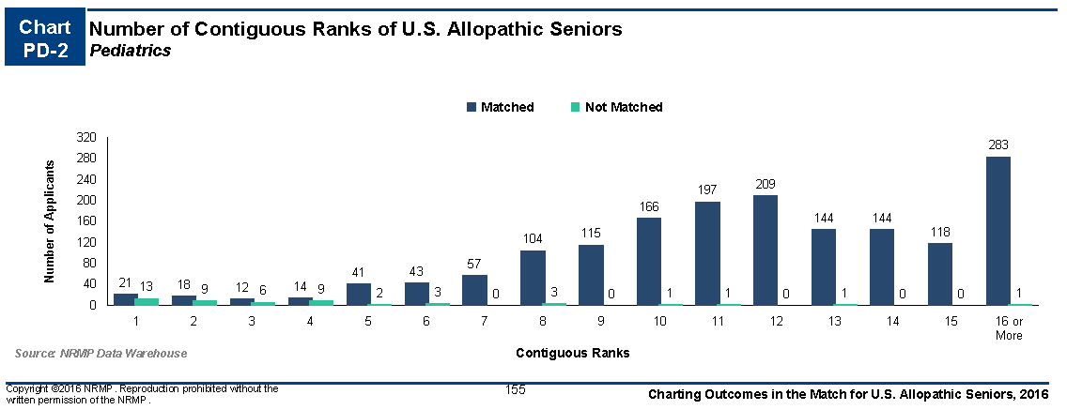
Numbers of programs students rank
Charting Outcomes in the Match NRMP 2016

Slide 48
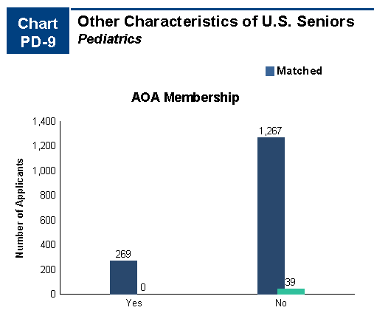
Is it important to be AOA?
Charting Outcomes in the Match NRMP 2016

Slide 49
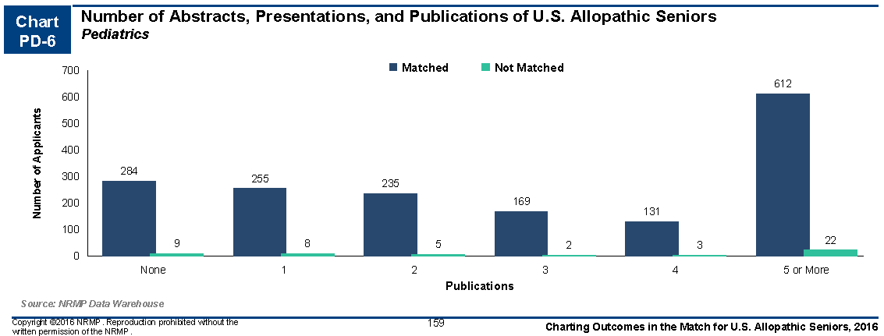
How many have published?
Charting Outcomes in the Match NRMP 2016

Slide 50
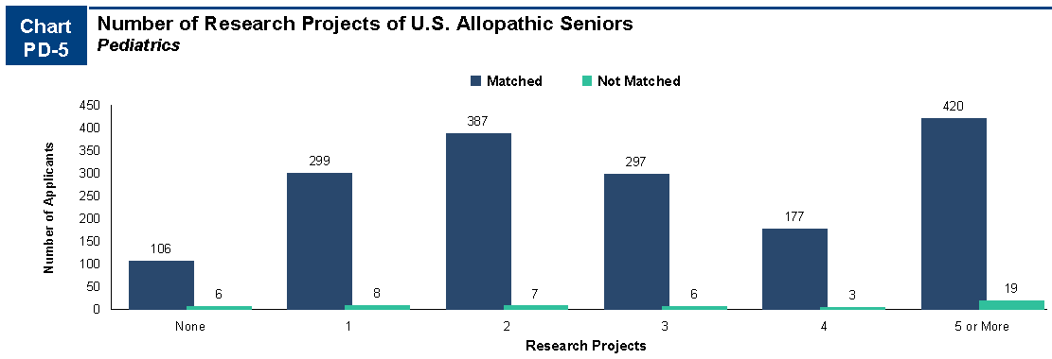
Done research?
Charting Outcomes in the Match NRMP 2016

Slide 51
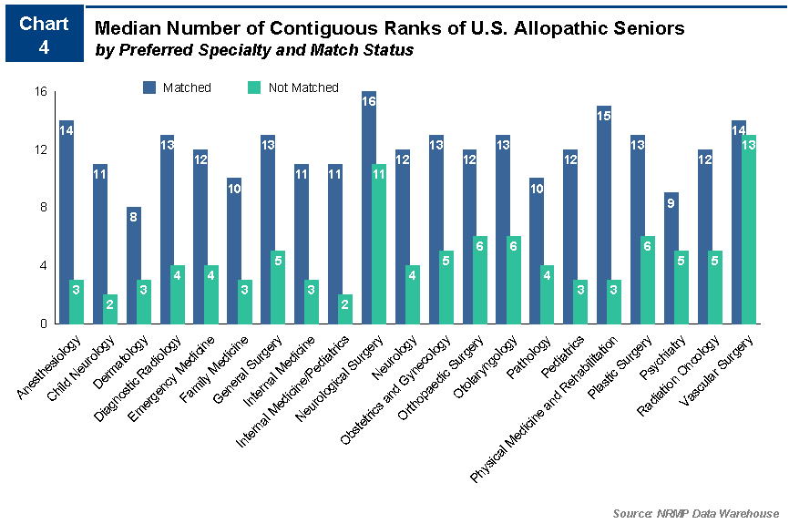
More comparative data 2016

Slide 52
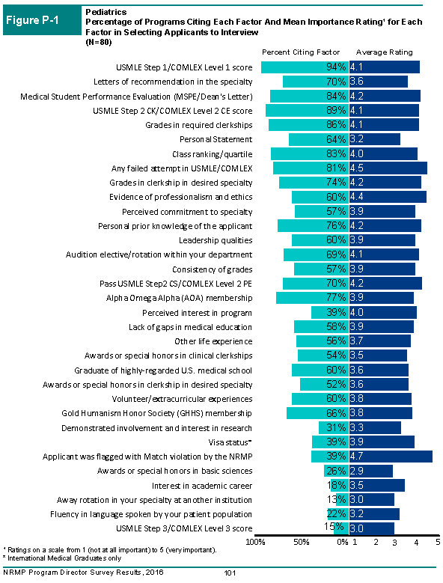
How do program directors select people to interview?
Notes:
92 responses from pediatric program directors

Slide 53

Applicant Ranking
What’s important?

Slide 54

What about Couples Match?

Slide 55

Reassuring Match Rates
US Seniors

Slide 56

Overall Match #s
US Allopathic graduates

Slide 57


Slide 58

What about USMLE?

Slide 59

USMLE Step 2

Slide 60

Are there thresholds?
Please note the small #s of responses from PDs here—30-40 responded. May not be representative.

Slide 61

When are interviews offered?

Slide 62


What do PDs think is important in predicting success in residency?

Slide 63


How many applications did students submit?

Slide 64

What subspecialties did pediatricians choose?
2015

