Slide 1
Hacks for Instructors:
Saving Time by Using Generative AI
Rachel Goc (she/her)
Anna Luce (she/her)
Original Contributors: Eun Sandoval-Lee and Bea Jimenez
Additional contributions: Katie Pearson
Notes:
Rachel:
Welcome, everyone!
Thank you for joining us for this workshop generative AI for the Northwestern classroom.
Today's session is called "Hacks for Instructors: Saving Time by Using Generative AI.”
This workshop was originally presented as a part of a week long series of workshops on the impact of generative AI on higher education at NU in the last week of August. Eun Sandoval-Lee, the Inclusive Teaching Project Administrator at the Searle Center for Advancing Learning and Teaching built this content with my co-leader today.
My name is Rachel Goc (she/her pronouns) and I’m a Learning Engineer in Teaching and Learning Technologies (TLT).
Anna:
Hello, everyone!
My name is Anna Luce (she/her pronouns) and I work as a Learning Engineer in Teaching and Learning Technologies (TLT).
Today, we are thrilled to continue the conversation about how to engage the world of generative AI into our teaching strategies.
We want you to think of this workshop as a toolkit that can inspire fresh approaches to student-centered course design and planning.
Our objective is for each of you to leave with at least one or two actionable ideas for using generative AI to enrich your students' experience while optimizing your time.
While we acknowledge that there's no magical "recipe" for effective teaching, consider the information and the ideas you'll encounter today as an adaptable "cookbook."
Basically, we're here to present a collection of "recipes," but you're the "chef" with the ability to tailor and refine these methods and tools according to your unique pedagogical style, course content, and student needs.
Rachel:
And in the title and throughout the session, we're intentionally referring to these methods as "hacks" like the colloquial language of "life hacks."
Bea and I (as well as the team of colleagues who put this week of events together) are aware of how important it is to support instructors with strategies and techniques to effectively manage your time and activities as educators in the midst of burnout, stress, and distress.
In this session, we are focusing on ways instructors can use generative AI to save time as instructors, which includes the work "behind the scenes" of classroom interactions with students.

Slide 2
Agenda
Welcome and Introduction
Poll
Hacks (presentation)
Individual Reflection (working break)
Group Discussion
Closing
Notes:
Agenda

Slide 3
Poll PollEv.com/rachelgoc985

Slide 4
Notes:
Do not modify the notes in this section to avoid tampering with the Poll Everywhere activity. More info at polleverywhere.com/support How familiar are you with using generative AI?
https://www.polleverywhere.com/multiple_choice_polls/kQ66cir17oNlDyvEXqIhC?state=opened&flow=Default&onscreen=persist

Slide 5
Understanding the Lingo
Machine Learning
The process by which AI systems learn from data and improve their performance over time.
Generative AI (GAI)
Large Language Models (LLMs)
AI that is trained on large quantities of text in order to interpret prompts and generate human-like text-based outputs.
AI model that learns from training data and use it to generate new content that resembles the original data.
Notes:
RACHEL
Starting with some common language

Slide 6
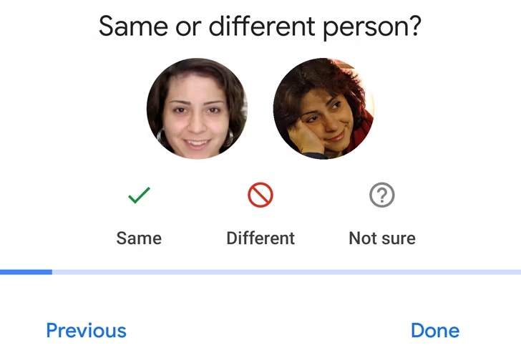
Training
The process of teaching AI to recognize patterns and make decisions based on input data.
Notes:
RACHEL
https://images.app.goo.gl/UJdFxKj9uDuMmk4Q6

Slide 7
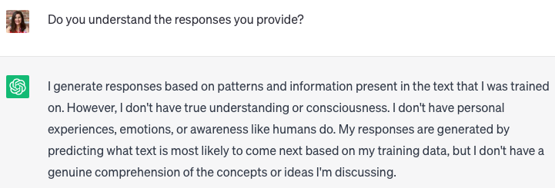
LLMs Predict Language Patterns
Output based on patterns observed in training
They do not understand the content
Notes:
RACHEL

Slide 8
Considerations
Data Storage
What happens to what is put into the chat?
Model/AI Training
Will my input be used to train or contribute to the AI model/company?
Transparency
What does the AI company tell me about their practices?
Bias
What biases may be reflected in the output from the AI?
How is bias framing the output?
Notes:
RACHEL

Slide 9
Large Language Models
Updated Oct 23
Tool | Company | See Images | Reads Files | Connect to Web | Data Cutoff
ChatGPT (3.5) | OpenAI | x | x | No | Sept 21
GPT-4 (Not Free) | OpenAI | Yes | Yes | No | Sept 21
ChatGPT Code Interpreter /Plugins | OpenAI | x | Yes | Limited | ~ Sept 21
Bard | Google | Yes | x | Yes
Claude 2 | Anthropic | x | Yes | No | Dec 22
Bing | Microsoft/ OpenAI | Yes | Yes | Yes
Notes:
RACHEL
Based on information from: https://www.oneusefulthing.org/p/how-to-use-ai-to-do-stuff-an-opinionated
This is a recreated version of a table on Ethan Mollick’s substack.
Runs Code
Sees Images
Can “see,” “understand,” and describe or analyze images
Reads files
Connected to the web
Data cut off
Clarify what these tools do and not do:
- generate text
- describing or captioning (based on a link?)
- how these tools connect to their class
- chatgpt has become a stand in for LLMS
Note that gpt4 is a paid service – ties to equity concerns

Slide 10
Where do I access generative AI?
Claude – https://claude.ai
ChatGPT 3.5 - https://chat.openai.com
Bing with GPT 4 – www.bing.com/new
Please note that these tools are public, and you have no assurance of data privacy, information protection, or intellectual property rights.
Northwestern Guidance on the Use of Generative AI (institutional data policy)
Notes:
RACHEL
Claude or ChatGPT 3.5.

Slide 11
How do I start?
Ask for a major concept from your field to be defined and explained at a specific level. For example, “Define and explain string theory with two specific examples at a high school level.”
Refine your prompt by:
Changing the role: “I am an instructor. Help me explain string theory at a high school level.”
Changing the level: “Define and explain string theory at a third-grade level.”
Changing the tone: “Define and explain string theory in a casual (or silly, with jokes, for an academic audience) style.”
Asking for more details on a specific part of the answer: “I don’t understand the first example. Can you explain in more detail?”
Request more information on any inaccuracies or odd parts of the response: “Cite an article that says Thomas Edison arrived at M-Theory.”
Ask for an outline of a three to five-page research paper with citations on the topic of circadian rhythms (or a topic in your field of interest).
Notes:
RACHEL

Slide 12
Questions to consider
What did you learn about the tools’ capabilities and their limitations?
Where can students use some of these capabilities to extend their learning in your courses?
How can you and your students critically engage with what is generated?
Notes:
RACHEL

Slide 13
Notes:
Do not modify the notes in this section to avoid tampering with the Poll Everywhere activity. More info at polleverywhere.com/support What kinds of things have you tried doing with generative AI?
https://www.polleverywhere.com/multiple_choice_polls/kXvhY96YQ3j5GuLLbCUXS?state=opened&flow=Default&onscreen=persist

Slide 14
Potentials of GAI in Education
Automating tasks | Leveraging generative AI efficiently and ethically | Opportunities for instructors to save time
Notes:
ANNA
As mentioned earlier, our objective is for each of you to leave with at least one or two actionable ideas for using generative AI for optimizing your time.
In this session, we hope to demonstrate several potentials of generative AI in education, including:
Automating tasks,
Leveraging generative AI both efficiently and ethically,
As well as (and especially), opportunities for you, as instructors, to save time!
Let's review some important information for us to consider with regards to prompt design.

Slide 15
Prompt Design
Character: The role you want the tool to play
Request: What you want the tool to do or generate
Adjust: Revise, clarify, or edit your initial prompt
Type of output: Provide parameters for your outcome
Examples: Include examples or additional content
Notes:
ANNA
This information may be redundant if you have attended previous workshops this week.
However, I think it is important to talk about prompt design since the prompts are the main "ingredient" in your "cookbook" to maximize your teaching preparation time.
Today, we will provide prompts you can plug-and-play, but if you are writing your own prompts, consider the following to ensure generative AI becomes your best teaching aid:
First up, we've got C - Character. Define the role you want the generative AI tool to embody—"You're the go-to math guru explaining complex concepts to curious minds," or "Imagine you're a sci-fi author crafting mind-bending discussion questions."
Now, let's talk about R - Request, which is what you want the tool to do or generate. Whether you need a summary, an explanation that even a student with zero background in your field would get, or discussion questions, generative AI can help you generate ideas for it.
A - Adjust. You can tweak your prompt to suit your needs better by following up with the tool. For instance, you can respond with "I want this explanation to sound more formal."
Let's talk T - Type of Output. This means telling the tool how you want the response to look. You can ask for a short list, a detailed explanation, or even just a quick sentence. It's choosing the style that suits your needs. Do you want it in a tweet, a rap, or a classic essay format?
And last but not least, don't forget E - Examples. To enhance the tool's comprehension, examples are key and give a little extra help for understanding what you're asking. You can provide examples, extra details, or suggest sources like authors, resources, or real-life examples to improve the tool's responses. It's like giving the tool a nudge in the right direction so it can give you a top-notch response.
But remember, you're still the "head chef" for your course, so please always check the responses and take our hacks as a guide, not as a definitive "recipe."
Other notes [if time]:
Be clear and specific (provide context and specifics)
Indicate desired output (bullet point list, table format, detailed explanation, word count, etc.)
Set desired tone (casual, formal, etc.)
Sequence prompts (maintain context over multiple prompts by referring to a previous interaction and continuing the conversation within that chat)
Provide examples (provide sample responses to guide the tool's understanding of the desired answer)
Ask for reasoning (GAI can provide support, resources, and/or show reasoning/alignment, but users should always verify accuracy)

Slide 16
Developing Course Materials & Assignments
Notes:
RACHEL: let's review a couple of hacks for saving time by using generative AI when it comes to developing course materials and assignments.

Slide 17
Developing Course Materials & Assignments
Providing Examples
Photo by Jason Goodman on Unsplash
Notes:
RACHEL
One hack to save time is utilizing generative AI tools for providing examples.
As an instructor, you may find yourself trying to come up with useful examples to point students towards success on their learning journey.
Perhaps you'd like to share some examples to illustrate what you mean when it comes to writing assignment topics, case studies or scenarios for classroom discussion, or ideas for small group projects.
But you may also have papers to grade, a research grant deadline around the corner, or a Zoom webinar on learning and teaching to attend in 5 minutes.
So, we suggest that you prompt generative AI tools (like ChatGPT or Character.AI) to help you get started.

Slide 18
Example Prompt
Generate a list of [item] for [activity] that [objective].
Notes:
RACHEL
Here is an example prompt that you can use to generate examples.
Here, "item" can refer to the example "thing" that you need generated, such as ideas, images, or sounds;
It is important to clarify the activity that this list is used for, like writing a short story, creating a brand vision board, or facilitating a group discussion;
And we recommend that you clarify the objective (or purpose) of the examples provided.

Slide 19
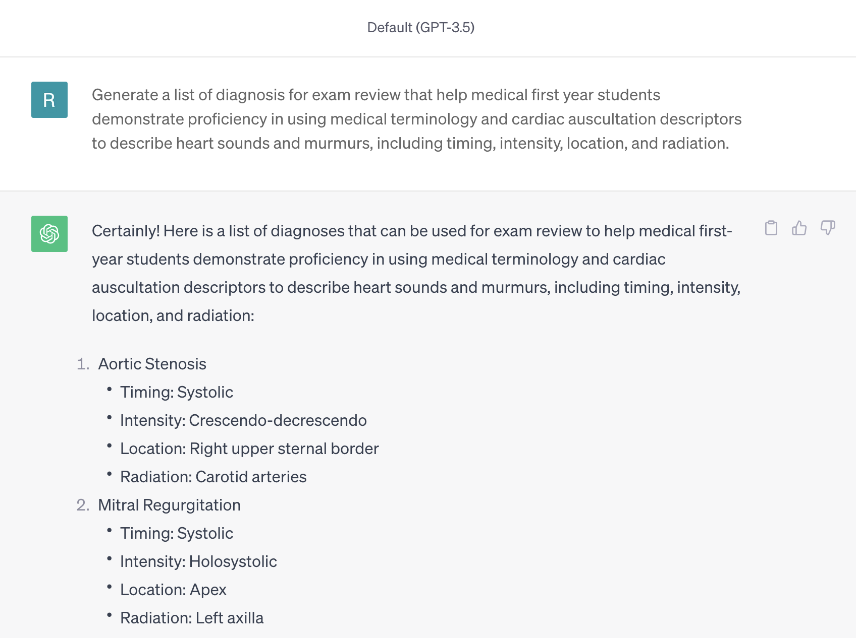
Notes:
RACHEL
As an example, here is a screenshot from a demo on
If you're interested, please refer to the link in the chat for the guide we developed based on the demo.
Link: https://searle.northwestern.edu/resources/our-tools-guides/learning-teaching-guides/generative-ai-text-tools.html
In the demo, we
https://chat.openai.com/share/521af816-4679-4345-a5d4-f8b5154da2ad

Slide 20
Additional Considerations
Specify the number of examples and example type.
Decide whether you want students to use the examples provided as part of their own work.
Distinguish access skills vs. target skills for the objective of providing examples.
Ask for analogies.
Notes:
RACHEL
There are a few things to consider when using generative AI for providing examples:
Specify the number of examples and example type. If you only need 3-4 examples, then you can specify this in your prompt. If you need more examples, ask for more!
Decide whether you want students to use the examples provided as part of their own work.
Distinguish access skills vs. target skills for the objective of providing examples. As an instructor, understanding the difference and relationship between skills students need to access their learning vs. skills that are the target for their learning is critical. In the previous example, the primary learning objective for the course and, therefore, why the assignment is meaningful is to aim for the target skill of using medical terminology . Brainstorming and ideating what the student is learning how to code (in this case, a video game) is not a skill the instructor is actively or explicitly assessing and, thus, this access skill that could present a barrier to or preclude some students from successful completion of the assignment.
Ask for analogies. Our brains love analogies. They connect something new—the content or ideas students are learning about—to something that's previously established in our brains. When we use analogies, it helps us understand how new things work because we have an existing paradigm for it. Generative AI tools can create analogies for us—and explain the connection so it helps students understand.

Slide 21
Developing Course Materials & Assignments
Summarizing or Explaining Difficult or Long Texts
Photo by filadendron on Unsplash
Notes:
RACHEL
Another way to save time is summarizing or explaining difficult or long texts.
As an instructor, you have the experience and expertise to critically review and "sus out" what is more or less accurate information, as well as understand the overall discourse that texts are a part of.
And we also know that with teaching comes the art of translating academic jargon, complex and nuanced theories, and distilling the main point of something for all students to know or understand.
To this end, there are some really neat generative AI tools that can assist you—especially when you're in a pinch trying to summarize an entire academic research paper to fit onto one slide of your lecture without resorting to a point 6 font size or explaining a complex idea to a group of students from various academic majors or professional interests.

Slide 22
Example Tools
Summarizing
Explaining
Elicit: a research assistant using language models to automate parts of researchers' workflows
SummarAI: a Google Chrome extension that summarizes PDFs, texts, and videos
MapDeduce: a tool that can summarize complex documents in any language and ask context-specific questions
TLDR this: an online text summarizing tool that automatically condenses long articles, documents, essays, or papers into key summary paragraphs
Explainpaper: a reading and explanation tool that allows users to upload academic papers, research papers, and other documents in PDF format
ELI5: a tool that simplifies complex or obscure topics and makes them easy to understand in the simplest of terms
Notes:
RACHEL
Depending on your needs and budget, you could save time using any (or all) of the tools listed here.
As far as summarizing tools that are mostly free to use,
Elicit is a research assistant using language models to automate parts of researchers’ workflows. Currently, the main workflow in Elicit is Literature Review. If you ask a question, Elicit will show relevant papers and summaries of key information about those papers in an easy-to-use table.
SummarAI is a free Google Chrome extension that summarizes PDFs, texts, and videos.
MapDeduce can summarize complex documents in any language and asks context-specific questions. This tool is free but also offers paid monthly memberships.
TLDR (or Too Long; Didn't Read) This is an online text summarizing tool that automatically condenses long articles, documents, essays, or papers into key summary paragraphs. You can get 10 summaries for free, and then there are monthly subscriptions options for $4-$8.25 USD per month.
When it comes to explaining tools that are mostly free to use, we suggest:
Explainpaper, which is a reading and explanation tool that allows users to upload academic papers, research papers, and other documents in PDF format. For now, this tool is free through registration.
The mission of ELI5 (or Explain Like I'm 5) is to simplify complex or obscure topics and make them easy to understand in the simplest of terms. Hence (and if taken literally with a specific sense of humor), it would be like explaining something in a way that a five year old would understand. You can use three tokens (or searches) per day for free. And, for fun, you can toggle sarcasm on or off!
A summarization and explanation tool that hasn't been released yet is ExplainThis, which you can sign up to be on the waiting list for.
Links:
https://elicit.org/
https://tldrthis.com/
https://chrome.google.com/webstore/detail/summarai/nfolcidakkjjmcdefcigbnhemccjfagg/related
https://www.mapdeduce.com/
https://www.explainpaper.com/
https://explainlikeimfive.io/
https://explainthis.ai/

Slide 23
Additional Considerations
There may be limitations with in-text figures, graphics, or illustrations.
Many summarization or explanation tools work with one or a few select languages (English).
Notes:
RACHEL
There are a couple of things to consider when using generative AI tools for summarizing and explaining:
There may be limitations with in-text figures, graphics, or illustrations—especially for tools that are primarily text-based.
Many summarization or explanation tools work with one or a few select languages (like English).

Slide 24
Assessing & Grading
Notes:
ANNA

Slide 25
Assessing & Grading
Developing Low-Stakes Quizzes
Photo by Jan Vasek on Unsplash
Notes:
ANNA
One pedagogical strategy that can significantly augment your instructional methodologies is the integration of low-stakes, frequent quizzes in your courses.
For those seeking a deeper exploration of this concept, I'm excited to mention a recent TEACHxperts event hosted by TLT where we had the privilege of hosting Ruthann Thomas, a distinguished cognitive scientist and Associate Director of the Teaching and Learning Lab at MIT. In her presentation, she talked about the application of retrieval and self-explanation practices. One of the practices she highlighted was the use of low-stakes quizzes.
We will post the recording of the session in the chat: (https://northwestern.hosted.panopto.com/Panopto/Pages/Viewer.aspx?id=9f73e77d-67f7-499c-a7a8-afdb0130d789)
Ruthann’s research shows that by exposing students to these low-stake quizzes we prompt them to retrieve information from memory, and we stimulate their long-term memory retention. Also, these quizzes can serve as learning catalysts. Ruthann's insight into incorporating these quizzes without grading brings an interesting perspective: when we alleviate the pressure associated with grading, we encourage students to perceive retrieval as a tool for learning.
In essence, these low-stakes quizzes can serve as an assessment instrument for you but also function as learning events for your students. Also, these low-stake types of quizzes offer you insights into student comprehension and can inform your following instructional adaptations.
However, I'm not going to pretend that crafting these quizzes is an easy task, it can be a time-consuming, and grading them, can be quite a challenge.
That's where generative AI can come into play.
Generative AI can assist you in creating practice quizzes. By automating these tasks, generative AI unleashes you from the clutches of time-consuming work, freeing you up to focus on the juicy parts of teaching.
Add chatgpt to add an asterisk next to the answer that gpt thinks is correct
Sean Nufer: https://www.howtocanvas.com/create-amazing-pages-in-canvas/chatgpt-quiz

Slide 26
Example Prompt
Create a quiz on the topic of [topic] for [audience]. The quiz should be [number] questions long and should be of [level] difficulty. The questions should be [type] and should cover a variety of topics, including [topics]. The quiz should take [time] to complete. The grading rubric should be based on a [points]-point scale, with [points] points per question.
Notes:
ANNA
Here we have one example of prompt you can use to generate ideas for your own practice quizzes. You will receive a copy of this presentation but feel free to so a screenshot right now. This prompt is design for you to fill the blanks with the:
Subject (e.g., math, science, English) and Topic (e.g., addition, fractions, poetry)
Grade level / audience (e.g., Graduate, Undergraduate)
Number of questions (e.g., 10 questions, 20 questions, 30 questions)
Difficulty level (e.g., easy, medium, hard)
Question type (e.g., multiple choice, true/false, fill-in-the-blank)
Number of Points
Feedback (e.g., provide feedback after each question, provide feedback at the end of the quiz)

Slide 27
Additional Considerations
Be as specific as possible about the subject, grade level, topic, and learning objectives.
Use clear and concise language.
Specify the number of questions, question type, and difficulty level (as appropriate).
Decide whether you want GAI to provide feedback after each question or at the end of the test.
Notes:
ANNA
Some considerations to bear in mind and a golden nugget: If you're "whipping up" multiple-choice or multiple-answer quizzes in Canvas, grading becomes easier. Canvas can grade automatically, and you can even set up automated responses for the right and not-so-right answers.
However, please be prepared—even though generative AI tools can excel at generating questions, your expertise is critical when evaluating tools' outcomes and determining their alignment with your goals.
It's worth noting that the tools' creativity might occasionally lead to the invention of non-existent facts.
Hence, the responsibility rests on your shoulders to ensure its results are accurate and contribute to the value of your course.

Slide 28
Assessing & Grading
Drafting Assignment Instructions
Photo by Siora Photography on Unsplash
Notes:
ANNA
Second hack in the assessing and grading area is drafting assignment instructions.
Instructions are like a GPS guiding students to assignment success.
Think about GAI as a tool that can help you create clear and compelling assignment instructions that align with your student learning objectives.
Think of it as a "recipe" for success, where each "ingredient" adds depth and meaning to your assignments.
Just like preparing a "dish," we'll start with the right "ingredients."
Gather your student learning objectives which are the key goals you've set for your course.
Then, with a generative AI tool, you can ask for help in creating assignment instructions that hit all the important categories for completion:
The purpose of the assignment,
The tasks involved,
The resources needed (remember to double-check their accuracy!),
And the criteria for success
and all the logistics around submission, format, etc.
But here's the "secret sauce"—when using generative AI to draft these instructions, make sure they're student-centered.
You can ask the tool to add those personal touches that connect with your students' backgrounds and perspectives. This way, your instructions become more than just guidelines; they become engaging and meaningful roadmaps for your students' success.
In other words, a generative AI tool can assist you with aligning your assignments with your objectives, all while adding that special touch to engage your students.
It's a win-win situation that saves you time and ensures your students have clear directions on their learning journey.

Slide 29
Example Prompt
Act as a university professor from a prestigious university. Create assignment instructions that include the following categories:
Purpose of assignment: [purpose here]
Tasks: [task here]
Students will be using the following resources:[resources here]
The criteria for Success is: [criteria]
This assignment needs to align with: [learning objective(s)]
Notes:
ANNA
Drafting assignment instructions
For instance, here we have the following prompt. Here are some things you might use when using GAI to create assignment instructions:
Student learning objectives
Ask for assignment instruction categories that include purpose, tasks, resources (verify accuracy), and criteria for success.
Emphasize learner-centered instructions by asking it to make connections to the learner’s background/perspective.

Slide 30
Additional Considerations
Utilize your learning objectives to help you build assessments that align to the learning domains and levels in your objectives.
You could build upon prior conversation to generate ideas for a course map or rubrics.
Notes:
ANNA
Extra topping: Utilize the student learning objectives you created to help build assessments that align to the learning domains and levels in your objectives.
You could build upon prior conversation to generate ideas for a course map or rubrics.
For instance, I have an example I would like to demonstrate in real-time: https://chat.openai.com/share/5e14569b-bde9-4d20-a3ad-eca731e52a9b

Slide 31
Assessing & Grading
Creating Rubrics
Photo by Port Elizabeth on Unsplash
Notes:
ANNA
The previous example talks about my next hack which is rubrics: Rubrics serve as a valuable resource in the grading process, offering a framework that enhances student transparency and ensures uniformity especially when multiple graders are involved.
Why do we like rubrics? Having a rubric, students gain a clear understanding of the expectations and criteria against which their work will be evaluated, and that can foster a sense of fairness and accountability.
Do I like creating rubrics? No!
With generative AI, you can use your assignment instructions to create a rubric as we saw in the previous example.
Imagine it's like giving the tool the "ingredients" to "cook up" a rubric that matches your assignments.
This way, you have a clear guide for grading, ensuring that assessment criteria is aligned with your teaching objectives.
By merging technology and pedagogy in this manner, you enhance the efficiency and effectiveness of your grading practices.

Slide 32
Example Prompt
Based on my assignment instructions, create a rubric that measures the items listed in criteria for success. Each criterion of the rubric should have at least three ratings: Excellent, Developing, and Needs Improvement.
The assignment instructions are: [assignment instructions with criteria for success section]
Format in a table.
Notes:
ANNA
At the end of this ChatGPT conversation, you can review the rubric:
Link:
With rubric https://chat.openai.com/share/8935b557-bfb3-497f-9e3b-f36e70c849a4

Slide 33
Additional Considerations
Build your rubric for your assignment in Canvas; in this way, you will be offering your students a roadmap to success.
Notes:
ANNA
Often, crafting the format and getting all the details right takes time. Thankfully, generative AI tools (like ChatGPT) have lots of information about successful rubrics in their dataset—and they've trained on it to identify patterns that can be helpful to you.
Ask the tool for a rubric—and be sure to include specifics about what you're looking for when you make the request.
Bonus: Ask it to format the rubric in a table for you; then, add the rubric to your Canvas course!
Link: https://digitallearning.northwestern.edu/article/2018/08/14/rubrics-make-grading-easier-and-faster

Slide 34
Engaging Students in Course Content
Notes:
RACHEL
We'd like to share one hack for saving time by using generative AI when it comes to engaging students in course content.

Slide 35
Engaging Students in Course Content
Representing Information in Multiple Ways
Photo by Kelly Sikkema on Unsplash
Notes:
RACHEL: This hack of representing information in multiple ways is inspired by the UDL (or Universal Design for Learning) principle of "multiple means of representation."
If you weren't able to join us last year for the UDL Practicum and would like to learn more about applying UDL principles for your instructional context, please check out the OER (or Open Educational Resource) at the link in the chat, which was developed by our colleagues in University Libraries and TLT.
Link: https://searle.northwestern.edu/resources/our-tools-guides/udl-oer.html

Slide 36
Example Tools
Speech-to-Text
Text-to-Speech
Glean
Otter.ai*
Panopto (Canvas)
Transcribe*
Zoom
* Can create timestamped transcripts from live and imported audio
Available to Northwestern faculty, staff, and students
Immersive Reader (Canvas)
Play.ht
SensusAccess
Notes:
RACHEL
This hack can be applied as far as converting speech-to-text and text-to-speech content.
If you present information through mini-lectures or regularly record audio or video content for students, you can use generative AI tools to create live transcriptions.
If you're like me and prefer to write your transcript verbatim, other tools can assist you with reading aloud.
I'm sure many of us are already familiar with tools like Alexa (by Amazon), Google Assistant, and Siri (by Apple) that feature speech-to-text and text-to-speech technology.
There are also many other tools you can use to save time with converting speech-to-text and text-to-speech that are specifically available to Northwestern faculty, staff, and students at no extra cost, which are highlighted here.
Our colleague, Katie, who co-facilitated the first workshop on Monday, presented a demo on audio-based generative AI during a workshop by the Searle Center earlier this year.
If you're interested, please refer to the link in the chat for the guide we developed based on the demo.
Link: https://searle.northwestern.edu/resources/our-tools-guides/learning-teaching-guides/generative-ai-audiotools.html
In the demo, popular speech-to-text tools that can create timestamped transcripts from live and imported audio were shared, such as Otter.ai and Transcribe.
Currently, Otter.ai is free but also provides priced plans for use.
You can try Transcribe for free but regular use and additional features are available through monthly or annual memberships.
Another honorable mention from the demo is a text-to-speech tool called Play.ht; there is a free version to try the tool with 2,500 words and one instant voice clone.
Links:
https://otter.ai/
https://transcribe.com/
https://play.ht/

Slide 37
Example Tools
Text-to-Image
Canva: an online graphic design tool (Northwestern SSO)
Bing Image Creator: an online tool for creating images on Bing
Craiyon: an image generator tool
Firefly: a feature in Adobe Photoshop that can add, expand, or remove content from images non-destructively, using simple text prompts
Notes:
RACHEL
This hack can also be applied for converting text-to-image content.
Instructors can use generative AI to get free and customizable images for lectures or illustrating ideas.
There are a few text-to-image tools you can considering using for free:
Canva is a free to use online graphic design tool. You can create an account and access it through the Northwestern SSO.
Bing Image Creator a free online tool for creating images on Bing.
Craiyon is a free image generator tool with options to upgrade to monthly or annual subscriptions.
In May, Adobe released and integrated Firefly in Beta mode as a feature of Adobe Photoshop. This tool enables users to add, expand, or remove content from images non-destructively, using simple text prompts.
As a side note, there is no longer a free trial for DALL-E 2, which is a popular system that can create realistic images and art from a description in natural language.
Links:
https://www.canva.com/
https://www.bing.com/create
https://www.craiyon.com/
https://firefly.adobe.com/
https://openai.com/dall-e-2

Slide 38
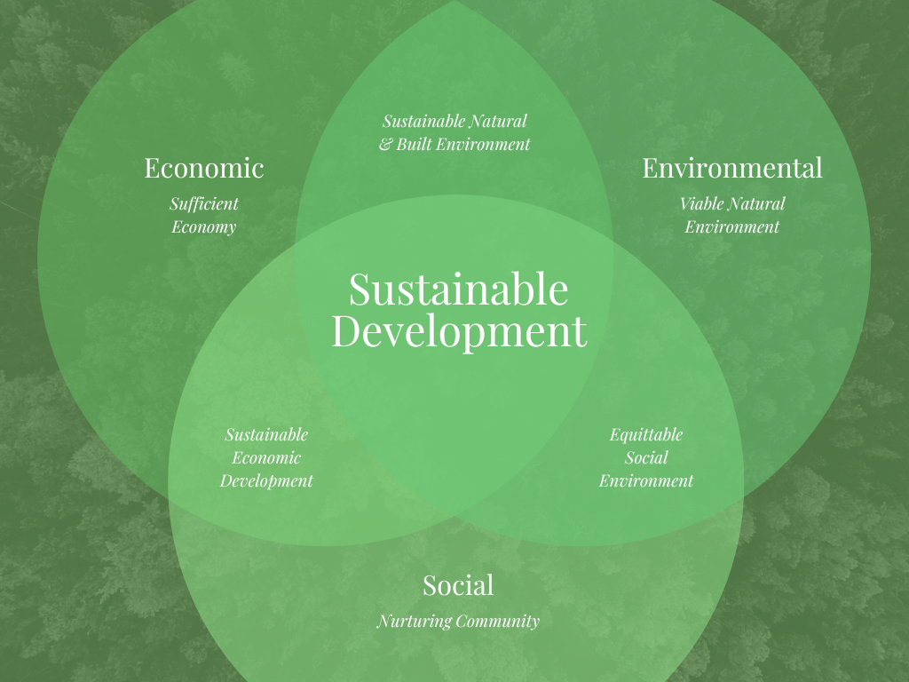
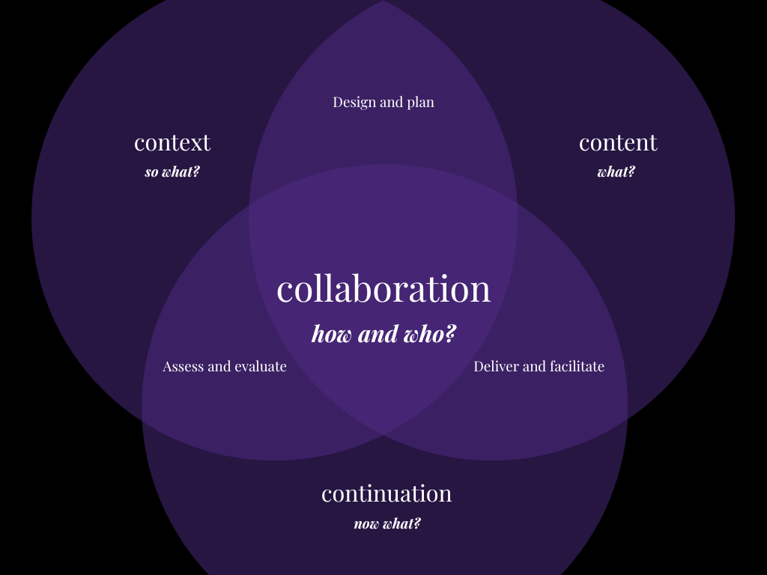
Notes:
RACHEL
Here is an example of how I saved by time using Canva to generate an image to represent a conceptual framework for a presentation.
I searched for "Venn diagram," and came across the green image on the left.
Then, I made some edits by changing the text and selecting objects and using the toolbar to format the different components (like the color of the circles and background) to suit my needs.

Slide 39
Additional Considerations
Correct the spelling of field-specific terminology or note mispronunciation of proper nouns.
Review transcripts for accuracy.
Be playful and mindful of tone.
There may be limitations for voices and languages.
Algorithms for representation across images can be biased.
Notes:
RACHEL
It's important to consider the following when using any of the tools we've mentioned for the purpose of representing information in multiple ways:
As a subject matter expert, you may need to correct the spelling of field-specific terminology for speech-to-text tools or note any mispronunciation for text-to-speech tools.
Review transcripts for accuracy when using speech-to-text tools.
When using text-to-speech tools, be playful and mindful of tone, as well as aware that there may be limitations for voices and languages.
Algorithms for generating images can be biased—so, if you're searching for something specific or interested in including intentionally and thoughtfully diverse representation of people and places, try clarifying your prompts.
Link: https://searle.northwestern.edu/resources/our-tools-guides/learning-teaching-guides/generative-ai-audiotools.html

Slide 40
Researching Technology for Your Teaching
Notes:
ANNA

Slide 41
Researching Technology for Your Teaching
Curating Automated Content
Photo by Luis Cortes on Unsplash
Notes:
ANNA
One way to save time is curating automated content by using generative AI to gather, filter, and present relevant information from various sources on a specific topic, such as technology in education.
This approach allows to efficiently stay updated with the latest developments, research, and trends without having to manually search through a multitude of sources.

Slide 42
Example Tools
Feedly: an RSS reader that can create rules to filter content, automatically add content to folders, and even automatically share content on social media
UpContent: a content curation tool that helps you find and share content from around the web
Poe: a platform that allows users to create, test, and access AI chatbots in the same page
Notes:
ANNA
If you are looking for a way to save time and improve your content curation, then automating content curation tools is a great option.
There are many different tools available, so you can find one that fits your needs and budget.
Here are some of the best content curation tools that offer automation features:
Feedly: Feedly is a popular RSS reader that offers a variety of automation features. You can create rules to filter content, automatically add content to folders, and even automatically share content on social media.
UpContent: UpContent is a content curation tool that helps you find and share high-quality content from around the web. You can create custom feeds based on your interests and UpContent will automatically curate content for you.
Poe: Poe is an artificial intelligence platform developed by OpenAI. It is named after Edgar Allan Poe, the poet. Poe.com AI leverages advanced natural language processing techniques, including OpenAI's GPT-3.5 model, to generate human-like text and engage in interactive conversation.
Link: https://docs.google.com/document/d/1CMFqkjcqO8bOcmP1MOWwZp3C_lU5_DH2gl9YP0_pG2M/edit?usp=sharing

Slide 43
Additional Considerations
Use relevant keywords and hashtags.
Track your results.
Be patient.
Notes:
ANNA
Use relevant keywords and hashtags. When you're curating content, use relevant keywords and hashtags. This will increase the visibility of your curated content and help you reach a wider audience.
Track your results. It's important to track your results so that you can see what's working and what's not. This will help you improve your content curation strategy over time.
Be patient. Content curation takes time and effort. Don't expect to see results overnight. Just keep at it and you'll eventually start to see results.

Slide 44
Individual Reflection Working Break
Notes:
For the next 10 minutes or so, we'd like to welcome everyone to participate in individual reflection as a working break.

Slide 45
Instructions
Go to Google Doc
Think of a course you would like to save time teaching using GAI
Find a blank line/row and fill it out
Optional: Add your contact information
Notes:
During this time, we'd like to ask you to go to a Google Doc, which we'll share a link to in the chat soon. - https://docs.google.com/document/d/1j9Y0jUAsjPjo7HhqRzLidBP9c87oPM8XJRQFNz_eFa8/edit?usp=sharing
The instructions are included at the top of the document, so once you open it, please:
Think of a course you would like to save time teaching using generative AI (and if you do not teach, think of an academic project that you would like to save time leading).
Find a blank line or row and fill it out, including:
A description of your instructional context for the course (or project) in mind—such as the academic discipline or field, class size, or location (as in whether it's online, hybrid, or in-person);
Choose one hack as a way to save time;
And imagine how to implement it in your course (or project) and share your reflection notes.

Slide 46
bit.ly/Hacksreflect

Slide 47
Hacks
Assessing & Grading | Hack #1 Developing Low-Stakes Tests Hack #2 Creating Rubrics Hack #3 Drafting Assessment Instructions
Developing Course Materials & Assignments | Hack #4 Providing Examples Hack #5 Summarizing or Explaining Difficult or Long Texts
Engaging Students in Course Content | Hack #6 Representing Information in Multiple Ways
Researching Technology for Your Teaching | Hack #7 Curating Automated Content
Notes:
(Eun)
Here is the list of the seven hacks we presented, which are organized within the area that folks indicated what they spend extra or excessive time when it comes to teaching from the earlier Zoom poll.
This list is included as a key at the top of the document for your reference.
And without further ado, here is the link to the Google Doc for you to use to individually reflect.
Link: https://docs.google.com/document/d/1j9Y0jUAsjPjo7HhqRzLidBP9c87oPM8XJRQFNz_eFa8/edit?usp=sharing
Again, we consider this individual reflection time as a working break.
And we know we just talked a lot at you.
So, you're welcome to use as little or as much of the next 10 minutes you need to reflect or just process everything.
With any remaining time, you can find another blank row and fill it out for another course (or project) or another hack to apply for the same course (or project) you're reflecting on.
It's also perfectly okay to take time for some self-care—stay hydrated with some water or tea, stretch and move around, or take some deep breaths and pause.
We'll give everyone a time check when there are five minutes remaining and one minute left.
…
There are 5 minutes remaining!
…
You have 1 minute left!
…
Thank you for engaging in this working break and adding to the Google Doc!
We hope that you found this time for individual reflection useful.

Slide 48
Group Discussion
Notes:
Now, we'd like to share the rest of the time with everyone for some discussion with one or two other colleagues in randomly assigned breakout rooms.

Slide 49
What are you thinking about regarding generative AI?
Notes:
Have you been experimenting? What have you learned? What ideas did this session prompt? Any advice if you’ve tried

Slide 50
Feinberg Resources
AI in research
AI at Feinberg
AI in teaching and learning
FSMEdTech@northwestern.edu

Slide 51
Closing and Reminders
GAI gives responses, not answers!
GAI can help with brainstorming, but instructors will have the metacognitive capacity to reflect on the content generated
Start thinking about the learning pathways and opportunities to model how to use GAI for colleagues and students
GAI is not our default/replacement but a benefit/supportive tool for learning and teaching (efficiently and ethically!)
Notes:
Anna:
First and foremost, it's important to understand that when we talk about GAI (or generative AI), we're not referring to a magical answer generator. Instead, think of it as a responsive partner in your teaching journey. GAI provides responses, but it's up to you, the expert instructor, to transform those responses into meaningful insights and directions.
Picture GAI as your brainstorming buddy. It can help spark ideas, suggest perspectives, and propose approaches, but the real magic lies in your metacognitive process—your capacity to critically analyze and reflect on the content generated. This is the same approach students should adopt when interacting with GAI. It's not about spoon-feeding answers; it's about nurturing critical thinking and learning through collaboration with GAI.
Furthermore, GAI can be a remarkable asset in crafting learning pathways. As an instructor, you have the power to model effective GAI usage for your colleagues and students. Showcase how GAI can assist in shaping lessons, designing projects, or exploring new ideas. This isn't about replacing your expertise, but rather enhancing it through technology.
And let's be clear: GAI is not a one-size-fits-all solution! It's not here to replace you as the instructor, but to stand alongside you as a valuable tool. It can be a tool that help you generating ideas for your teaching and learning practices. Embrace it to elevate your efforts, ensuring that you and your students engage with it thoughtfully, creatively, and responsibly. With GAI, we're not just teaching and learning; we're co-creating knowledge and experiences together, efficiently and ethically!

Slide 52
Thank you!

